Slide 1
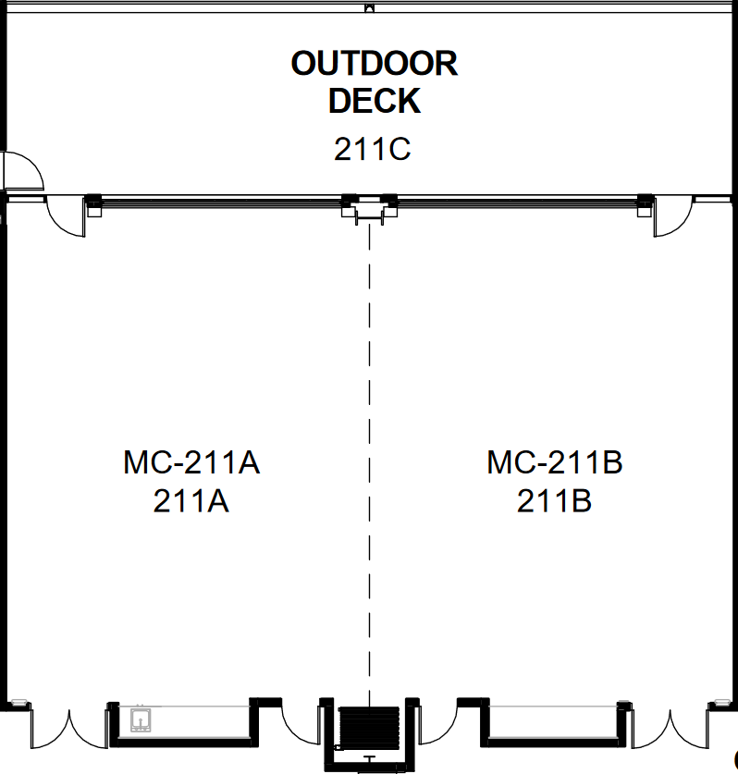
Event Name
Date
Total Resources:
(#) Round Tables
(#) MC Tables
(#) Chairs
(#) ea. Trash/Recycling Bins
Key:
Table
Chairs
Round Table
Gray/White5-ft Table

