Slide 1
Mesa Pathways President’s Cabinet Report December 5, 2017
Ashanti Hands, Vice President Student Services Bridget Herrin, Associate Dean, Research and Planning
http://bit.ly/mesapathways

Slide 2
About Guided Pathways
The Guided Pathways framework creates a highly structured approach to student success that:
Provides all students with a set of clear course-taking patterns that
promotes better enrollment decisions and prepares students for future success.
Integrates support services in ways that make it easier for students to get the help they need during every step of their community college experience.

Slide 3
Guided Pathways Depends on US.
Guided Pathways is not a “one-size-fits-all” initiative…
The enormity and diversity of the California Community Colleges system requires that each college take a customized, self-guided approach.
Guided Pathways is an opportunity for our college to set our own goals and determine our best path to success.

Slide 4
Four Pillars of Guided Pathways
Clarify the Path
Enter
the Path
Stay on the Path
Ensure Learning
Create Clear
Curricular
Pathways to
Employment
and Further
Education
Help Students
Choose and Enter Their
Pathway
Help Students
Stay on
Their Path
Follow Through, and Ensure that Better Practices are Providing Improved Student Results.

Slide 5
Key Elements of Guided Pathways
Programs that are fully mapped out and aligned with further education and career advancement while also providing structured or guided exploration for undecided students.
Redesigning and integrating basic skills/developmental
education classes to accelerate students to college-level classes.
Proactive academic and career advising from the start through completion and/or transfer, with assigned point of contact at each stage.
Structured onboarding process including improved placement tests
and co-requisite instruction that provide students with clear, actionable, and usable information they need to
get to the right start in college.
Early alert systems aligned with interventions and resources to help students stay on the pathway, persist, and progress.
Instructional support and
co-curricular activities aligned with classroom learning and career interests.

Slide 6
Gearing Up for Implementation
IEPI Workshop
Self-Assessment
Multi-Year Work Plan
Funding Allocation
October 30, 2017
December 23, 2017
March 30, 2018
April 30, 2018

Slide 7
Self Assessment Development Phases
Targeted feedback (October 5-31)
Faculty Chairs
Committee leaders
Program Directors/Managers
Operational staff
Administrators
Open Forum (November 7)
Online review and public input (November 3-19)
President's Cabinet Retreat (November 14)
Planning & Institutional Effectiveness (November 18)
Academic Senate (December 11)
Classified Senate (December 7)
ASG (December 6)
Present to P-Cab for final review (December 5)
Submit to District for final signature (December 15)

Slide 8
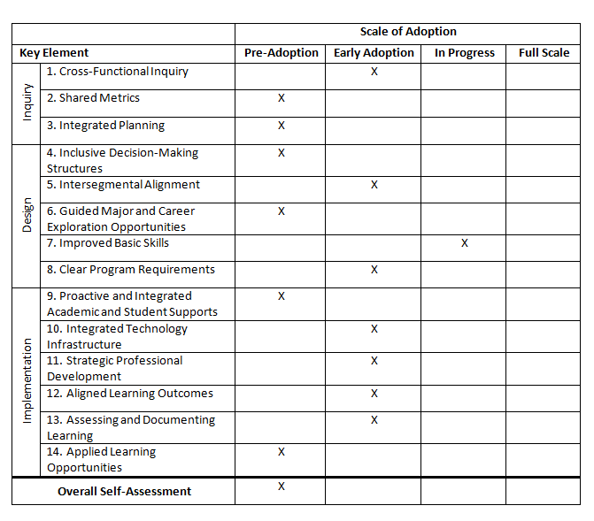
Guided Pathways Self-Assessment Tool

Slide 9
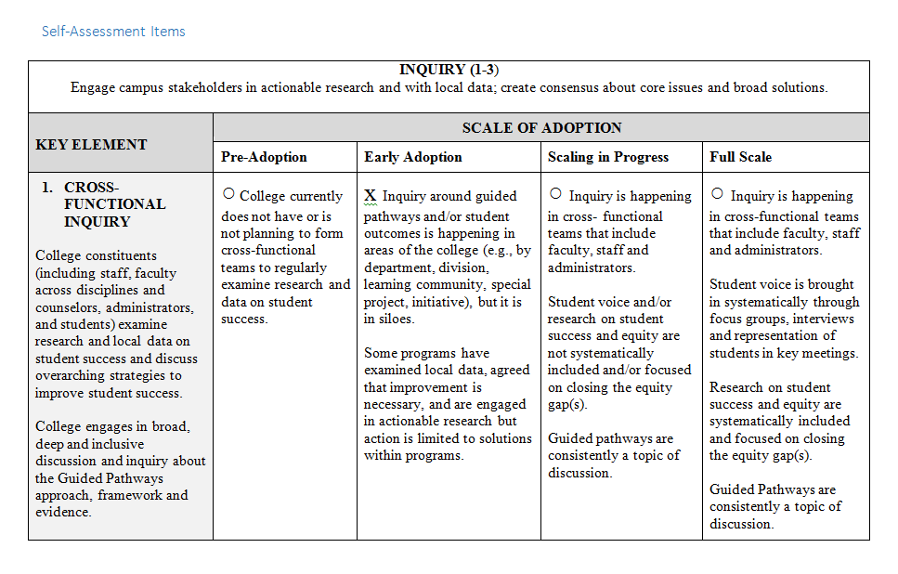
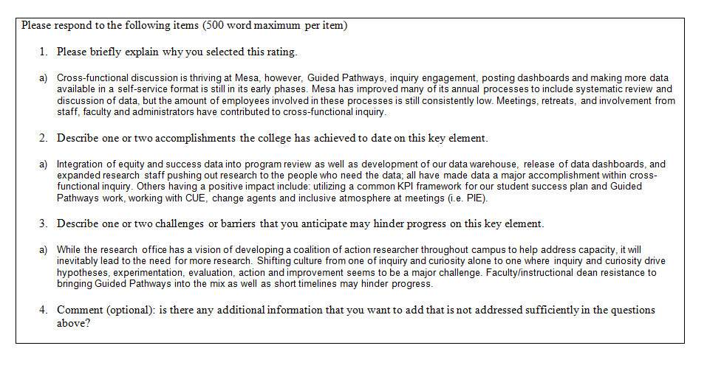
Guided Pathways Self-Assessment Tool:
Example

Slide 10
Questions?
http://bit.ly/mesapathways

