Slide 1
2017 ILO Survey Results

Slide 2
Background
Survey items derived from Mesa ILOs and operational definitions
Indirect assessment of student learning upon completion of a degree or certificate program
Student reflections on development in ILO areas

Slide 3
Mesa ILOs (2017)
Critical Thinking
Global Awareness
Personal Awareness and Civic Responsibility
Self-Awareness and Interpersonal Skills
Communication
Technological Awareness

Slide 4
Survey Instrument
6 Likert scale matrix questions (1 per ILO)
Ratings on a 5-point scale
Open-ended comment boxes for each ILO
6 additional open-ended items
Success factors, challenges, recommendations
Students asked to rate the degree to which their experiences at Mesa improved their skills/abilities in each area
1
No improvement
2
Improved slightly
3
Improved moderately
4
Improved
5
Improved to a great degree

Slide 5
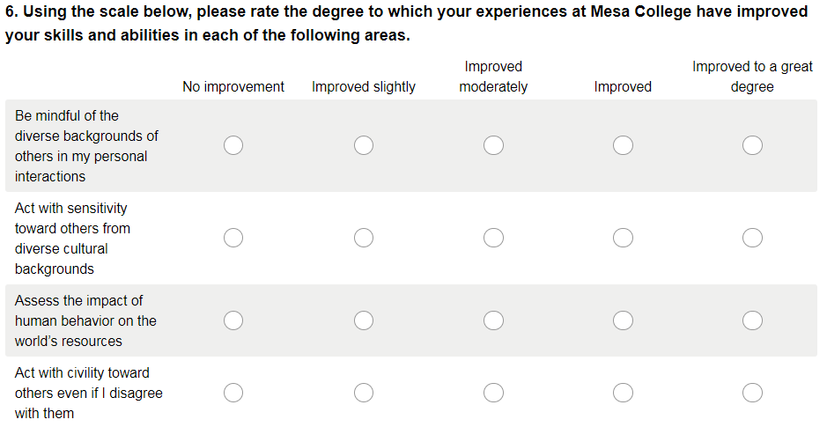
Survey Screenshot
Example: Global Awareness

Slide 6
Methodology
Survey sent to students in May 2016
Data collection: May 2016
One invitation, two reminders
Target population: students applying for graduation during spring semester
N=1,567 students
Survey invitation sent via email to 1,565 students

Slide 7
Survey Participants
453 students responded to the survey invitation
391 students completed the survey
Response rate= 25%

Slide 8
Graduation Semester & Award
No response <1%

Slide 9
Summary of Responses by ILO
Not at all
To a great degree

Slide 10
Communication

Slide 11
Communication

Slide 12
Critical Thinking

Slide 13
Critical Thinking

Slide 14
Global Awareness

Slide 15
Global Awareness

Slide 16
Personal Awareness

Slide 17
Personal Awareness

Slide 18
Self-Awareness

Slide 19
Self-Awareness

Slide 20
Technological Awareness

Slide 21
Technological Awareness

Slide 22
Popular Programs of Study (Among Respondents)
Psychology (35)
Business Administration (23)
Other Business (16)
Sociology (11)
Interior Design (10)

Slide 23
What Did Students Say Most Influenced Their Success @ Mesa?
Instructional faculty (132)
Students’ own motivation (80)
Support of family, and friends (48)
School services, programs, and resources (27)
Counselors (24)

Slide 24
Top Challenges While at Mesa
Time management (78)
Personal challenges (66)
Academics (64)
Parking and transportation (30)
Course availability (24)
Instructional styles and approaches (24)

