Slide 1

Program Review Training
Equity-Minded and Inquiry-based reflection and planning
Notes:
Welcome to training

Slide 2
Vision for Institutional Effectiveness, Research, and Planning
To Be The Leading College Of Equity And Excellence…
by inspiring a culture of equity-minded action research, reflection, and inquiry
Notes:
Disarming Time
1. I would like to start by sharing the vision of my office:
2. The Program Analysis for Equity and Excellence section of Program Review that we will be going over today was designed with this vision in mind.
3. My role (and the role of my office) is not to speak the truth, but to simply support research and inquiry that leads to action. We don’t want data for the sake of data. Information should be examined in the context of following an ongoing improvement cycle.

Slide 3
What do you hope to get from today’s session?

Slide 4
Objectives
Review Analysis for Equity and Excellence Section of Taskstream
Review Data Dashboards
Review additional resources available for inquiry-based reflection
Discuss strategies for identifying patterns and trends in data
Additional things you’d like to know…
Notes:
Review Analysis for Equity and Excellence Section:
Review Data Dashboards: Where to find them, how to use them, etc.
Additional resources: What are those and where to find them.
Strategies to identify patterns and trends in data.
Any additional things (perhaps something they hoped to get from today’s session).

Slide 5
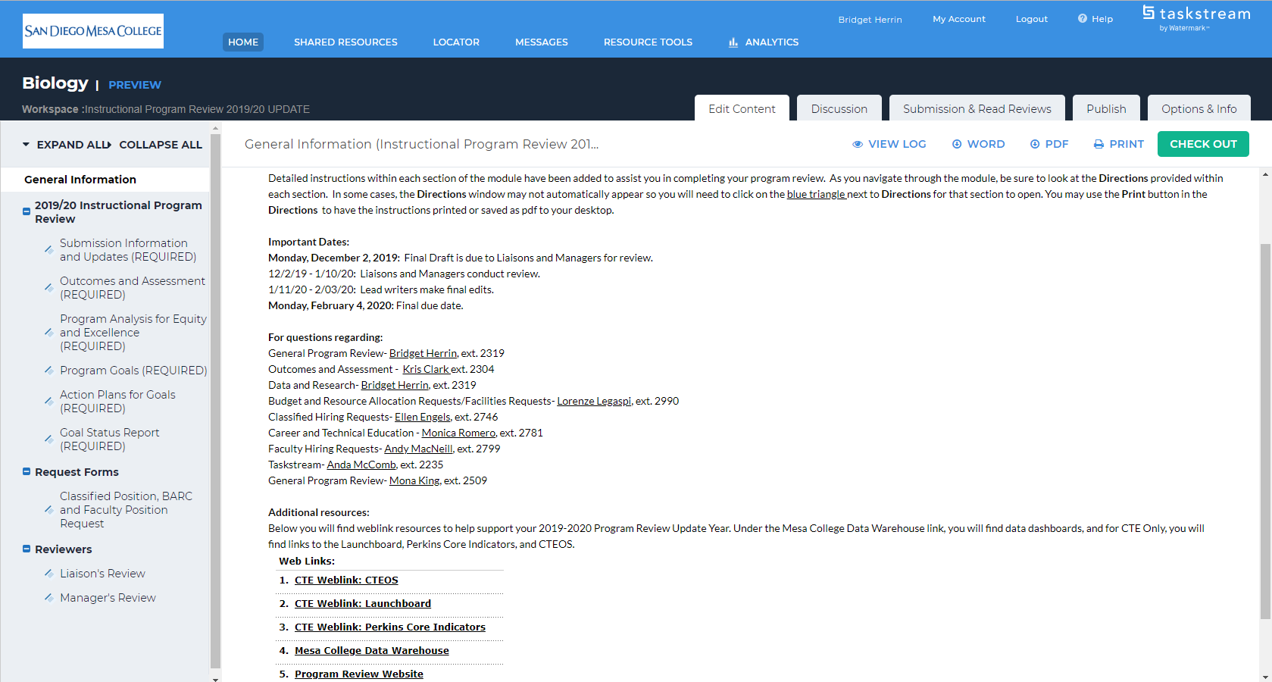
A look at Taskstream
Notes:
Let’s start by taking a look at Taskstream: This screenshot is what you see when you click on “Instructional Program Review 2019/20 UPDATE” link from you Taskstream home page and select “General Information.”
-Student Services and Administrative Services will look somewhat similar.
From here you can navigate to the “Program Analysis for Equity and Excellence” section, to the “Action Plans for Goals” section, as well as the BARC, CHP, and FHP forms (Please note that these forms are not available as of now).
I also want to highlight that within this page you can find links to the sources that will assist you in completing this section. You can also find links to these resources in our Program Review Homepage.

Slide 6
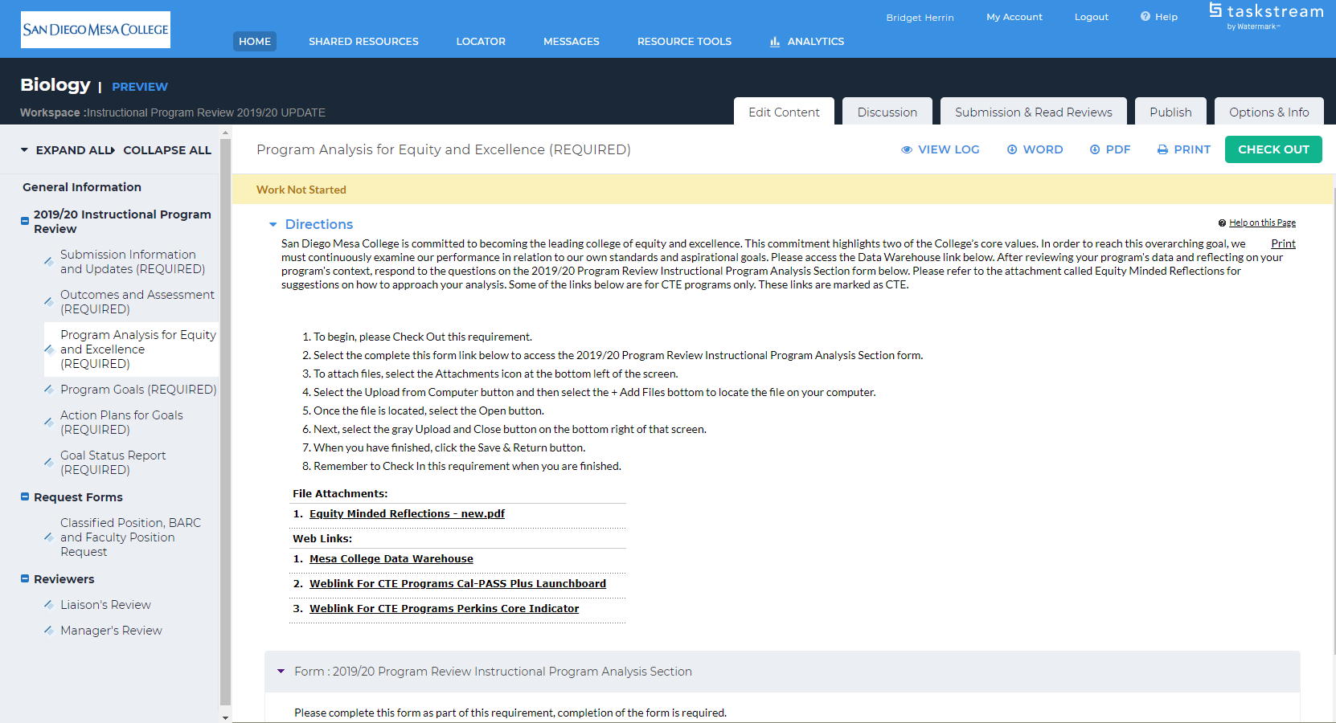
Program Analysis for Equity and Excellence
Notes:
Let’s take a look at how the Program Analysis for Equity and Excellence section in Taskstream:
-The page also includes instructions and contact information
-Is another place you can find resources in addition to the General Information tab and our Program Review homepage.
-Note that some resources are only CTE specific.
From here you can also check out the Program Analysis for Equity and Excellence form.
Transition: we are going to take a look at the questions included in that form next…

Slide 7
Part A: In this section, please analyze your program in terms of course success metric. Start by disaggregating the available data by race, gender, and any other parameters of interest to your program and answer the following questions.
A1. What patterns do you notice with regard to equity in course success at the program level by race/ethnicity?
A2. Do these patterns persist over time (e.g., look at the last five years)? Describe if equity gaps are increasing, decreasing, or staying the same?
A3. What factors may have influenced these results? What are your most significant findings?
A4. How have you/might you alter practices to increase student success and reduce equity gaps?
A5. How does your program contribute to the College's identity of being a Hispanic Serving Institution?
A6. Have you identified resource needs? If yes, please list.
A7. Do any of your program goals address these implications or needs? If not, please develop a new goal that addresses your findings and subsequent reflection.
Notes:
The questions you see on the screen are the same than those on the handout.
Note that this year we will be focusing on one single metric: Course Success.
-There is a lot of data and this is just one of many metrics
-The goal is not to figure out if something good or bad. We are concerned with learning and how it can be improved.
-Course success through the lens of equity simplifies the process of equity minded reflections and should help facilitate dialogue within your departments.
Transition: We are going to come back to these questions, but first, Let take a look the resources you have available to help you answer them.

Slide 8
FHP Form

Slide 9
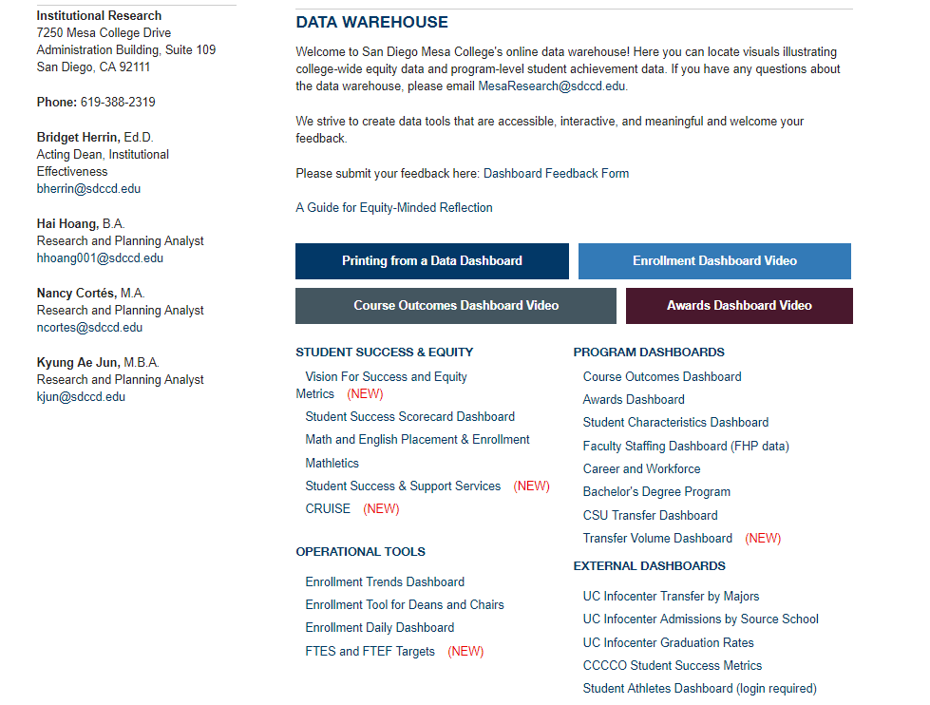
Tableau Dashboards
Notes:
#1: Data Dashboards-internal data readily available.
Those are the two dashboards that will assist you in completing this section. The FHP dashboard is currently being validated and will be available soon.
For that reason, we are going to focus on the “Course Outcomes Dashboard.”

Slide 10
Components of a dashboard
Introductory Page
Tabs Across the top
Filters
Reference lines
Info Buttons
Equity Gap Analysis
Updated On:
Notes
Notes:
Introductory page: overview and basic info
Tabs: for navigations
Filters: how the carry through, how to clear them, etc.
Reference lines: what they mean.
Info button: hoovering over for additional information and tips
Equity Gap Analysis: what it mean and how to look at it
Updated On: data
Notes: the details

Slide 11
External Resources
Tool and Resources Link to IR Website
SDCCD IR
  Research Reports
  Awards
  Misc.
  Student Profiles
  Enrollment/FTES
Statewide Data Sources
  DataMart
  CTE Launchboard
  Cal-PASS Plus
  O*NET
Notes:
#2: External Resources.
This powerpoint presentation will be posted to our website. So you can access these resources by following these links.

Slide 12
Considerations
Understand the definitions and nuances of your data
Develop guiding questions and hypotheses
Looking for patterns/trends
  Across time
  Across/between groups
  Across other characteristics (course level/modality, etc.)
  Between datasets
Looking at outliers/anomalies
Infer meaning, draw conclusions, ask more questions
Notes:
As you look at your data, it’s important to keep in mind the following considerations:
Understanding the nuances: for example, your program or a particular course might be serving all students vs. students majoring in that discipline.
-We are providing the data, but you are the ones that are extracting meaning from it.
As you look at your data, develop guiding questions or hypothesis. For example, HSI Programs might theorize that additional student supports should improve course success rates for Latinx students.
How do you look for patterns?
Look for outliers
Infer meaning, draw conclusions, ask more question.

Slide 13
Part A: In this section, please analyze your program in terms of course success metric. Start by disaggregating the available data by race, gender, and any other parameters of interest to your program and answer the following questions.
A1. What patterns do you notice with regard to equity in course success at the program level by race/ethnicity?
A2. Do these patterns persist over time (e.g., look at the last five years)? Describe if equity gaps are increasing, decreasing, or staying the same?
A3. What factors may have influenced these results? What are your most significant findings?
A4. How have you/might you alter practices to increase student success and reduce equity gaps?
A5. How does your program contribute to the College's identity of being a Hispanic Serving Institution?
A6. Have you identified resource needs? If yes, please list.
A7. Do any of your program goals address these implications or needs? If not, please develop a new goal that addresses your findings and subsequent reflection.

Slide 14
Think Pair Share
A1-8 minutes
Notes:
Pair-Up.
Choose your own program or agree with your partner which program you are going to look at.
Spend 4 minutes answering A1 on your own.
Share with your partner what you found.
Share with the group.
Final questions?

Slide 15
Action Planning and Areas of Focus
Connect plans to analysis
  Analysis identifies equity gap for Latinx students in a specific gateway course
  Action plan seeks to develop the faculty who teach that course, include culturally relevant materials into the course curriculum, embed tutors, etc.
  Create goals to support this
Leverage existing programs and resources
Notes:
Go over how the questions are structured: Making observations → finding patterns → drawing meaning → developing actions plans → how your program fits into the big picture →
What resources do you need
A4: Helps you begin thinking about an action plan. When answering this question, you can think from the perspective of the department.

Slide 16
Parting thoughts
We are not seeking TRUTH just one of many truths
Dozens of variables influence student success but pervasive and persistent patterns can be compelling places to begin our work
Don’t get trapped in false dichotomies
Data and assessment are inextricably linked to a culture that values effective pedagogy and andragogy
Student success data is, ideally, learning centered.

Slide 17

“Inquiry is a change strategy, become a researcher of your own practice”-E.Bensimon
You don’t need data to maintain the status quo.

Slide 18
The Team
Office: A-109 Phone: 2509
Bridget Herrin, Acting Dean
Hai Hoang, Analyst
Kyung Ae Jun, Analyst
Nancy Cortes, Analyst
Anda McComb, Admin Tech
Mona King, Sr. Secretary

