Slide 1
Travel and You
How you can prepare for the adventure of PeopleSoft
ClassiCon 2017

Slide 2
So what is the process anyway?
There are 2 basic routes any given TA will follow:
Employee Paid
District Paid (pre-pay, cash advance)
Both routes start with the Pre-Authorization Travel Form, and end with an Expense Report.

Slide 3
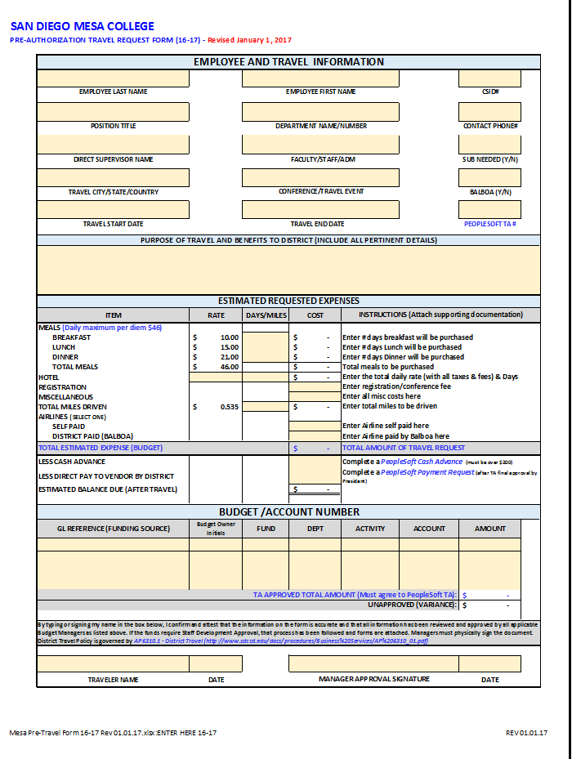
The Pre-Authorization Travel Form
This is a MANDATORY form for ALL travelers before ANY Travel Authorization can be entered in PeopleSoft:
http://www.sdmesa.edu/college-services/administrative-services/forms/
Along with this form, you will need to bring travel documents, presented later in the FAQs.
The form is in excel so you can populate / print,
or print / fill manually
This form needs to be completed with:
Budget number(s)
Original signatures of budget manager and
direct supervisor.

Slide 4
Employee Paid Travel
Travel Authorizations (TA) should be entered for approval in PeopleSoft at minimum 4 weeks in advance
The TA MUST be approved before the travel happens
Please note the process we are about to show is a basic workflow and does not account for all special circumstances.

Slide 5
District Paid (it’s a little different)
Travel Authorizations should be entered for approval in PeopleSoft at minimum 6 weeks in advance.
Traveler’s can have District Pre-Pay for the following common expenses:
Air fare (through Balboa Travel)
Hotel
Conference Registration
Meals
The Complete list will be addressed in the FAQs
The TA MUST be approved before the travel happens and in order for pre-payments to be processed.
Please note the process we are about to show is a basic workflow and does not account for all special circumstances.

Slide 6
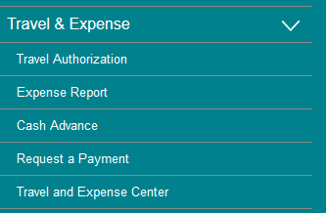
TA FAQs
When do I need to enter a TA?
Verify with Business Services if you have access to PeopleSoft: Travel and Expense
When you have travel with expenses, a TA
needs to be entered and approved in
PeopleSoft.
If you have travel WITHOUT expenses,
please contact Payroll, you do not need to
submit a TA.
What is the difference between a Pre-Auth Travel Form and a TA in PeopleSoft? Aren’t they the same? No!
Your Pre-Authorization form confirms:
What expenses are being funded by what budgets
Demonstrates manager approval for the travel.
The information from the Pre-Auth is then entered into your PeopleSoft TA
The PeopleSoft TA goes through another approval workflow to ensure funding is secured for your travel and…
… to account for your travel as a district employee.

Slide 7
TA FAQs Contd.
How far in advance should I enter my TA? The minimum times presented?
Ideally, as soon as you know you will be traveling. The times presented are truly minimum times to provide enough notice to process the TA correctly or correct errors.
These minimum times do NOT include time for your travel Pre-Auth. Please work with your budget managers and supervisors to get approval in advance of these minimum times.
What are considered back up travel documents for my TA?
Conference Registration Confirmation notices
Conference Agenda
Air fare reservation
Hotel reservation
What needs to be attached in my TA in PeopleSoft?
Pre-Authorization and back up travel documents as noted above

Slide 8
TA FAQs Contd.
I have multiple budget funding my travel. What should I do?
Contact Business Services x2771 to ensure budget numbers are properly entered into the TA
I want certain expenses pre-paid. How do I ask for this?
Please reflect pre-payments on both your pre-auth travel form AND your TA in PeopleSoft
I’ve gone beyond the minimum time.
What should I do?
A TA must still be submitted and approved.
Please work with Business Services if you have
questions or concerns and to make sure the TA
moves along in a timely manner

Slide 9
TA FAQs Contd.
I entered my TA with time to spare, but it’s been a while and I still haven’t received my approval. What should I do?
Please call Business Services x2771 to follow up on your TA.
You said my travel can’t happen without TA approval. How do I know if it’s approved? Doesn’t entering it count? No!
You will receive an email generated via PeopleSoft that your Travel Authorization has been approved.

Slide 10
Pre-Payment FAQs
How do I know if an expense can truly be pre-paid, regardless if it’s on my pre-auth and TA?
Please contact Business Services to confirm if the vendor is in the system.
It is the traveler’s responsibility to confirm if the vendor accepts checks and to make sure payment deadlines are met (i.e. registration deadlines).
What are the limits on a Cash Advance?
For cash advances, the minimum is $200.00.
If all of the advance is not used, the traveler will have to reimburse SDCCD for the unused funds.

Slide 11
Pre-Payment FAQs Contd.
What are additional expenses which can be covered under pre-payments / district paid travel?
Air fare (through Balboa Travel)
Hotel
Conference Registration
Meals
Transportation, and miscellaneous
When and How do I request pre-payments or cash advances (district paid travel)?
Once you receive email notification that your TA has been approved, please contact Business Services x2771. All pre-payments and cash advances are processed through Business Services.

Slide 12
Expense Report FAQs
I’ve completed my travel. Am I done in PeopleSoft? No!
An expense report must be submitted to close out your travel authorization.
The expense report is a separate process and must be linked to your TA.
The expense report is how you will be reimbursed for your actual expenses and to reconcile any pre-payments.
I’ve gone over my approved TA amount. Now what?
Please contact the budget manager to see if additional funding is available.
If additional funding is approved, the Pre-Auth needs to be updated to reflect this new amount with new signatures and dates.

Slide 13
Expense Report FAQs Contd.
How long to I have to enter my Expense Report after I get back?
Per district policy, you have 10 days to from your return date to enter your expense report.
If you go past these 10 days, please contact Business Services x2771.
What needs to be attached to my Expense Report?
Pre-Authorization Form
Name badge (if provided)
Conference Agenda
Receipts for all expenses

