Slide 1
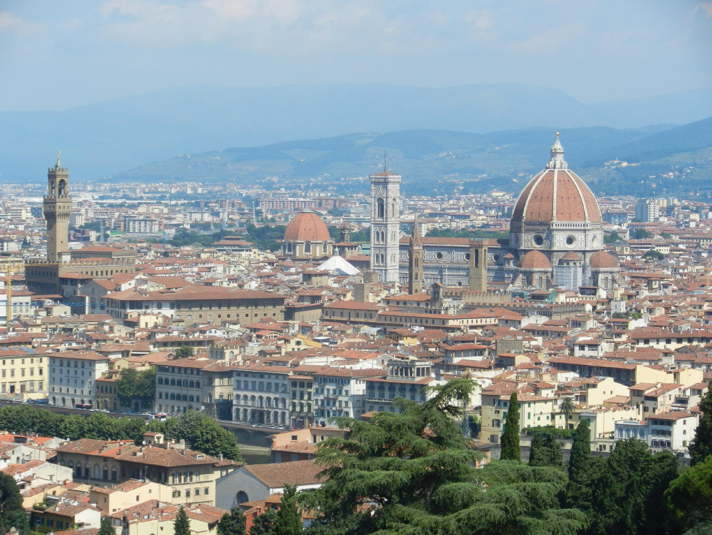
San Diego Mesa College
FLORENCE, ITALY
Study Abroad
Summer 2019
June 1st - June 28th 2019
www.sdmesa.edu/academics/study-abroad/

Slide 2
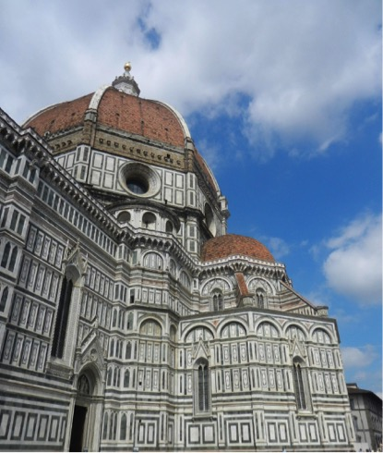
Spend your summer in historic Florence, Italy earning units and making memories that will last a lifetime.
June 1st – June 28th
2019
“To travel is worth any cost or sacrifice.” — Elizabeth Gilbert

Slide 3
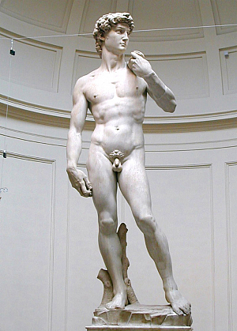
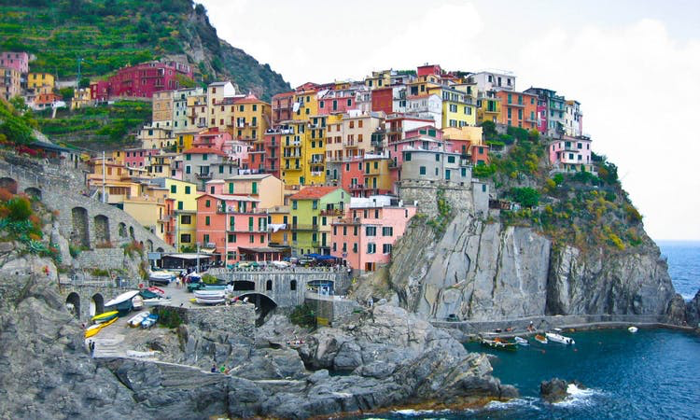
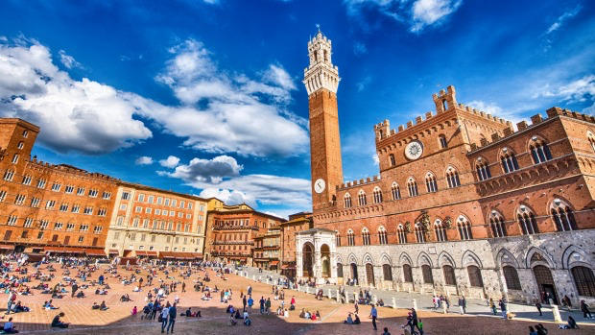
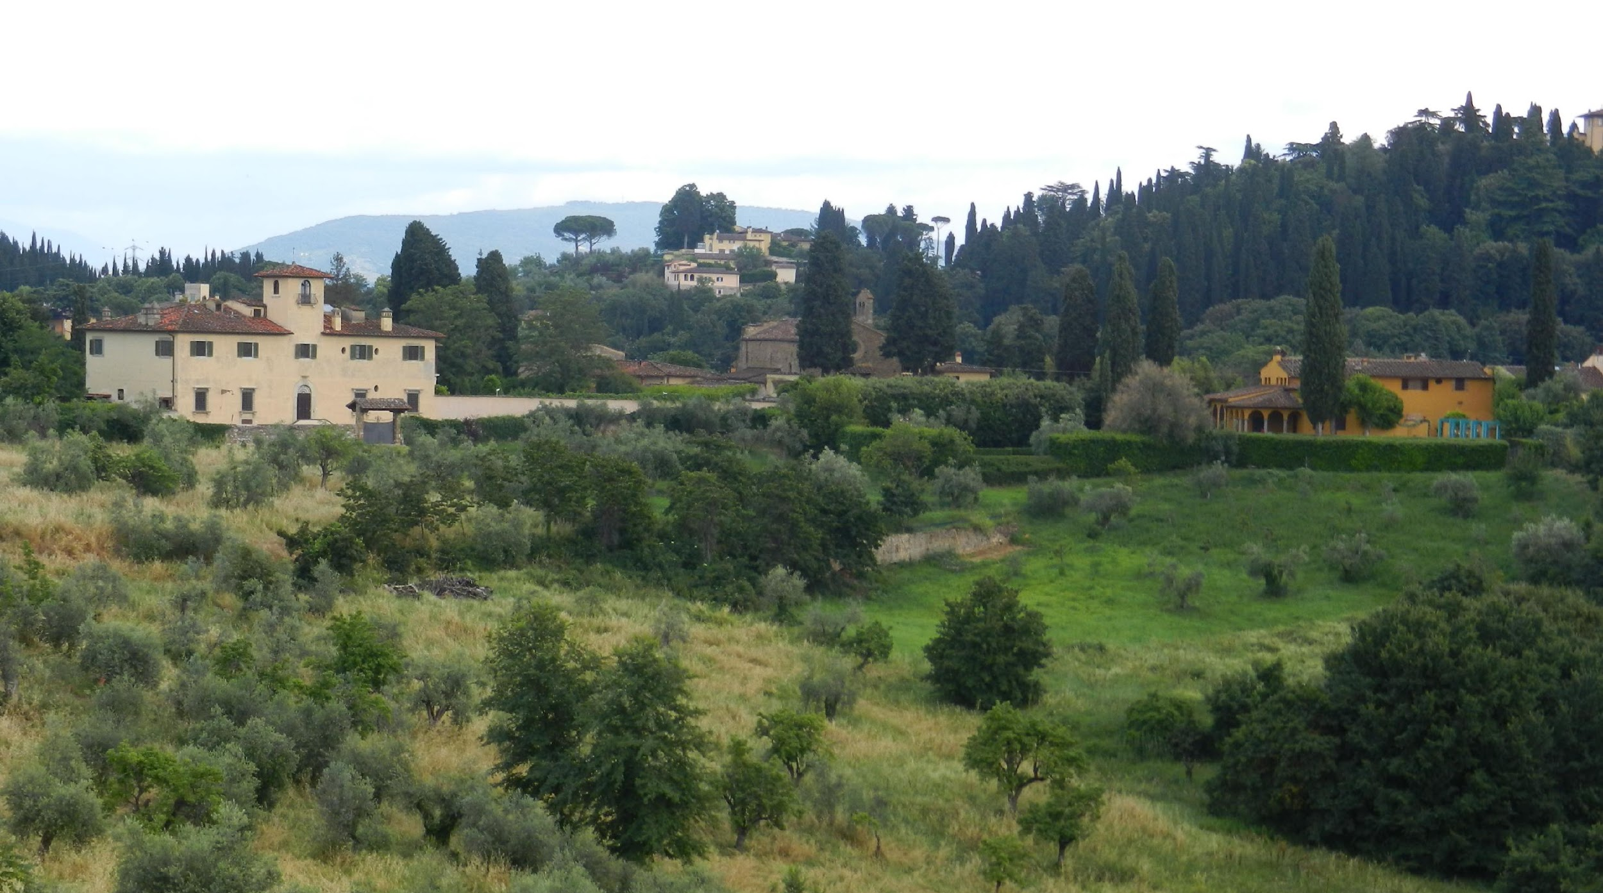
Group Activities Included
Visit the coast of Cinque Terre
Trip to the towns of Siena and San Gimignano
Guided tours of the Uffizi Accademia galleries
Tour of the Boboli gardens
Tour Tuscany and visit an olive oil producer and a winery

Slide 4
Courses
We will be offering:
Italian 210/211, Italian Conversation. 9-12PM M-Th
Italian 102 is a prerequisite
Biology 180, Plants and People. No prerequisite 1-4PM M-Th
Take one or both
Both with an Italian twist

Slide 5
Self Explorations
Museo Galileo
Ponte Vecchio
Climb the Duomo
Baptistery of St. John
Natural History museum
Open markets
Piazzale Michelangelo
Bardini gardens
Tuscany countryside
Neighboring towns
Etc.

Slide 6
The world is a book, and those who do not travel read only a page. – Saint Augustine

Slide 7
“Nobody can discover the world for somebody else. Only when we discover it for ourselves does it become common ground and a common bond and we cease to be alone.” ― Wendell Berry

Slide 8
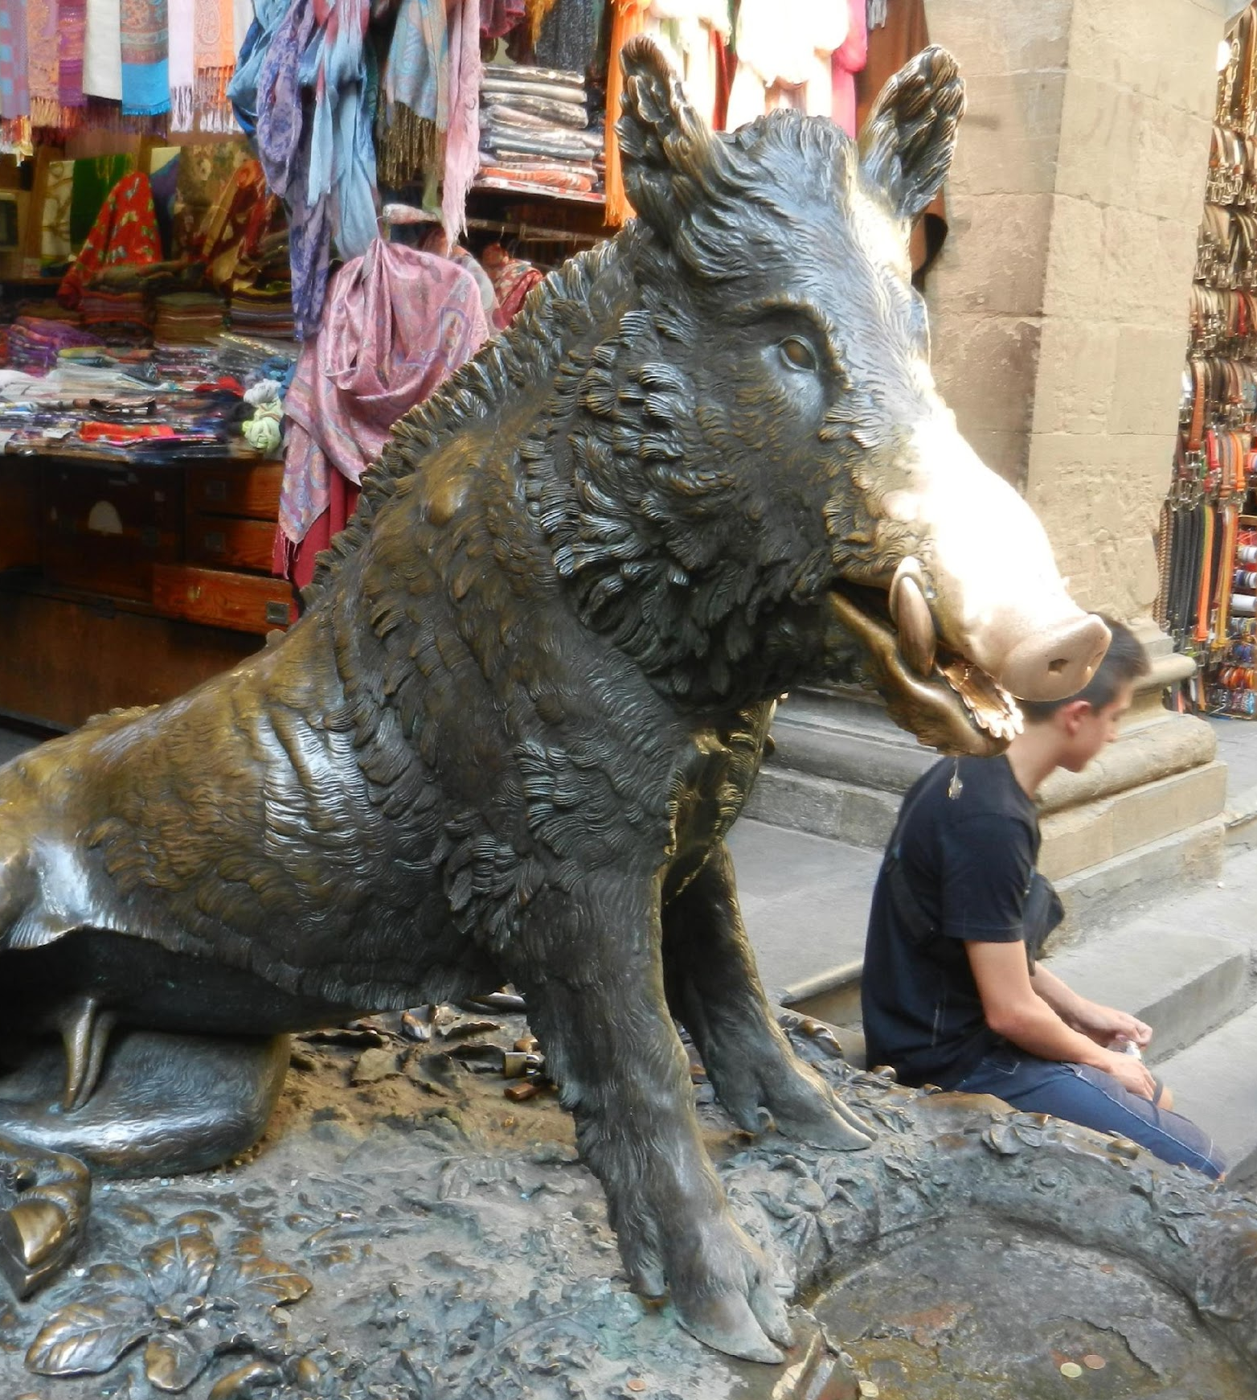
COST
$2945 per Student
$200 less if more than 45 student attend

Slide 9
What is included
Excursion to coast of Cinque Terre
Excursion to Siena and San Gimignano
Guided tours of the Uffizi gallery and the Accademia gallery
Guided tour of the Boboli gardens
Tour of an olive oil producer
Tour of a Tuscany winery
A 30 euro per student academic fund
Basic health insurance

Slide 10
What isn’t included
Round trip airfare
(possible air package 10+ students)
Passport fees
Incidentals
$125 refundable damage deposit
SD Mesa College -Tuition & books/materials
Optional excursion to Venice
Food – Caffe, Gelato, Pizza, Pasta
Optional meal vouchers
Optional overnight visit to Venice $325

Slide 11
Housing
Students will stay in shared apartments or will be in homestays (homestays cost an additional $250)
Homestays
Breakfast everyday and 5 dinners/week
Students share a room with other S.D. students
Apartments
Meals on your own in shared apartments
Restaurant vouchers available for extra costs
10 meals for $175

Slide 12
Application Deadline: February 22nd, 2019
Enrollment deposit Fee of $450
Due before February 22nd, 2109
Final Payment April 5th, 2019
Payment schedule & payments
Apply at:
https://secure.aifsabroad.com/Partnership/application/welcome.aspx?cpi=QGNYHA1A5H3H

Slide 13

Is financial aid available? Yes..
Talk to Financial Aid adviser, Pilar Ezeta in
the Financial Aid Office in I4-107
☎ (619) 388-2817
Include Italian 210/211, Biology 180
in your ed. plan to use financial aid
Read the FAQs for SDCCD Study Abroad
Programs in our website.
Ask family & friends to fund you.
Create a site such as www.gofundme.com
Apply for a Gilman Scholarship, Due Date: October 2nd or March 6th 11:59pm CDT
http://www.iie.org/Programs/Gilman-Scholarship-Program

Slide 14
1. Fill out application, access it on web site
2. Pay AIFS $150 application fee *
3. Notify professors you have joined at
mesaflorence2019@gmail.com
4. Attend an informational session
5. Begin payments on schedule.
Contact us with any questions:
Prof Lodovica Guidarelli
lguidarelli@gmail.com
Prof Bill Brothers (Biology)
bbrother@sdccd.edu
*If the program doesn’t fill your $150 will be refunded along with all fees.
If you withdraw your $150 & associated payments are not totally refundable.
See contract for all details.
Reserve your spot today!
Don’t miss out

Slide 15
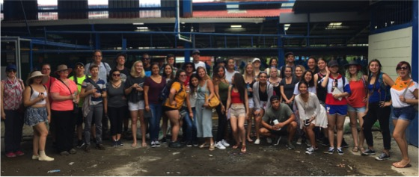
Saluti !
Join us today
Applications will be available on the website
http://www.sdmesa.edu/academics/study-abroad/mesa-college-study-abroad-programs.shtml

Slide 16



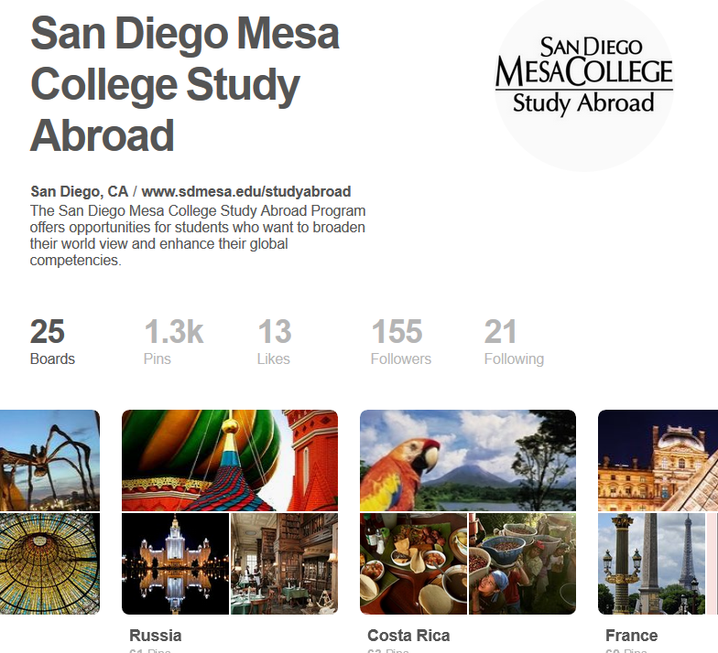
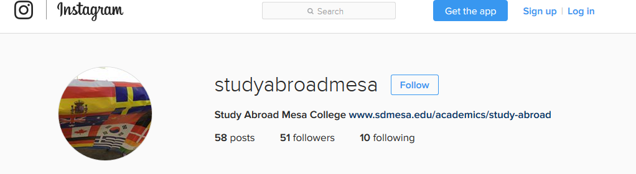

Stay connected…San Diego Mesa Study Abroad

Slide 17
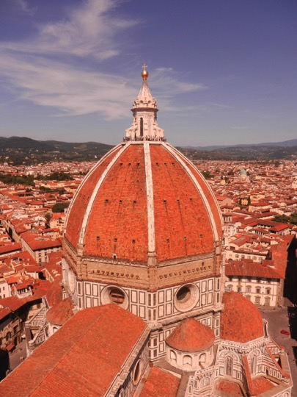
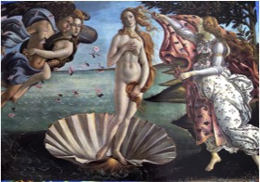
Climb the Duomo in Florence
See Michelangelo’s David
See Botticelli’s Birth of Venus

Slide 18
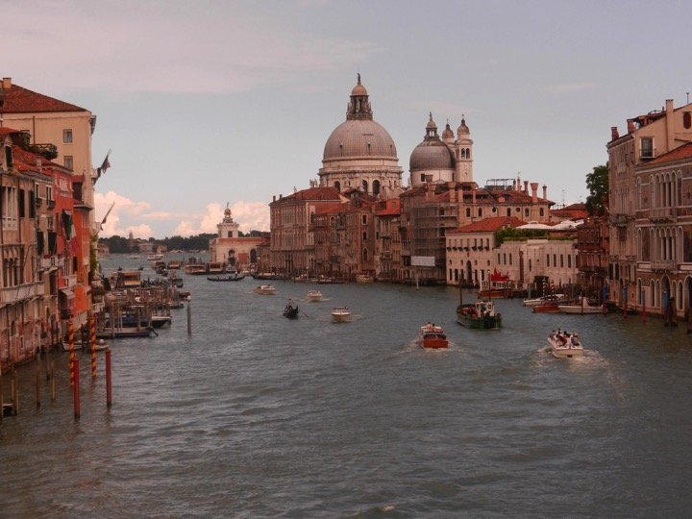
Visit Venice

Slide 19
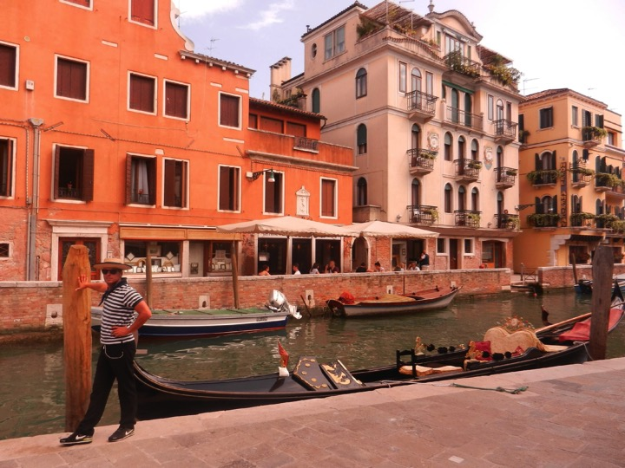

Slide 20
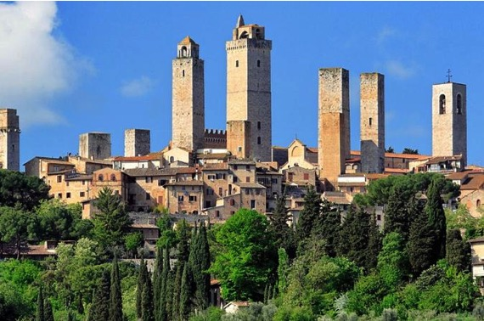
San Gimignano

