Slide 1
BENJAMIN A. GILMAN STUDY ABROAD SCHOLARSHIP MESA COLLEGE STUDY ABROAD
Study abroad scholarship

Slide 2
Gilman Scholarship: Workshop Agenda
1. Introduction
2. Overview
3. Eligibility
4. Selection Criteria
5. Essay
6. Current Study Abroad Programs in
How to write a successful study abroad essay
https://www.iie.org/gilman

Slide 3
Overview
One’s destination is never a place, but a new way of seeing things”-Henry Miller

Slide 4
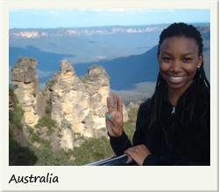
Overview
Gilman Scholarship Overview
Awards up to $5000 to study abroad!
•Awards up to $8000 for Critical Need Languages!
✓ Arabic (all dialects)!
✓ Chinese (all dialects)!
✓ Bahasa Indonesia!
✓ Japanese!
✓ Turkic (Azerbaijani, Kyrgz, Turkish, Turkmen, Uzbek)!
✓ Persian (Farsi, Dari, Kurdish, Pashto, Tajiki)!
✓ Indic (Hindi, Urdu, Nepali, Sinhala, Bengali, Punjabi, Marathi,
Gujarati, Sindhi)!
✓ Korean!
✓ Russian!
✓ Swahili

Slide 5
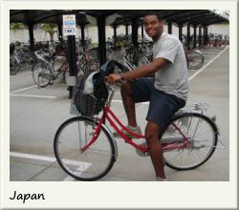
Eligibility
PELL GRANT
(at the time of application)!
MIN. 4 WEEKS* 2 week community college students
Longer duration preferred)!
STUDY ABROAD PROGRAM
planned in advance!
TRAVEL WARNING LIST COUNTRIES-no funding allowed

Slide 6
Selection Criteria
Students with high financial need!
➡Students studying in non-traditional countries,
especially outside of Europe, Australia, New
Zealand!
➡Students with diverse ethnic backgrounds!
➡Students from COMMUNITY COLLEGES!!!!
➡Students with disabilities

Slide 7
Essay. Impact, impact
Statement of Purpose Essay
(What do you have to gain from the program
academically, professionally and personally)!
2. Follow-on Service Project Proposal Essay
(explain how you will inspire others to
pursue their own experiences abroad)!
3. IMPACT! IMPACT! IMPACT!
7, 000 characters (including spaces)=1,5
pages single spaced/per essay

Slide 8
Making an impact

Slide 9
Connect all your goals, tell your story

Slide 10
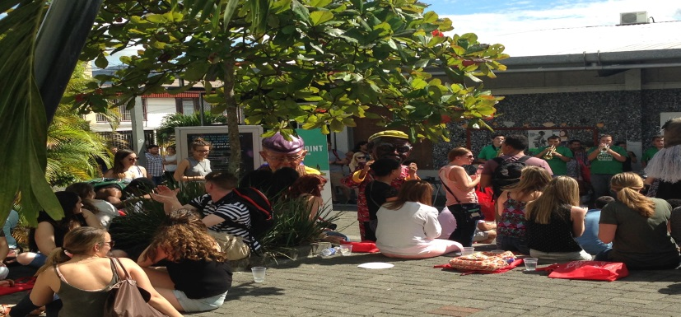
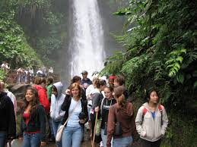
Current Study Abroad Program in Costa Rica Jan 1-25, 2019, -“Spring program”

Slide 11
Summer programs
Paris, France Madrid, Spain
Florence, Italy London, England
You have TWO opportunities to apply!

Slide 12
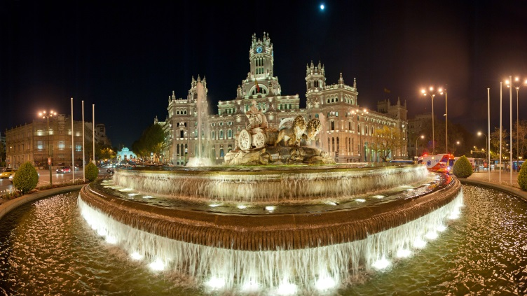
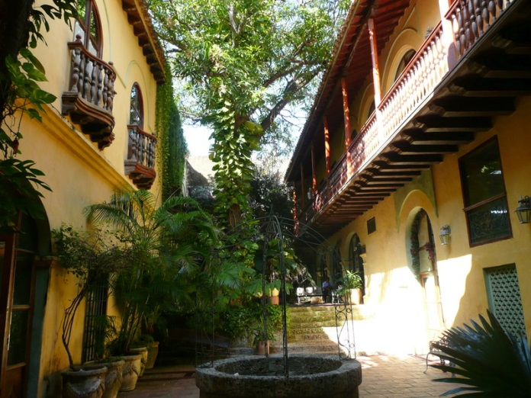
Current Study Abroad Program in Madrid, June 23- July 20th, 2019

Slide 13
Deadlines & Timeline
Summer & Fall Program
Applications
DUE: OCT 2nd^{th} Winter & Summer Early Application Deadline
Summer March 5th
Online Application at
www. gilmanapplication.iie.org

Slide 14
Application
Spring 2019
Benjamin A. Gilman International Scholarship Application
Application Information
Applicant Name:
Email:
Address:
U.S. Citizen:

Slide 15
Current Institution:
Transfer Institution(s):
Major:
Minor:
Expected Degree:
Expected Graduation Date:
Type of Academic Evaluation:
Overall GPA:
Spanish Languages and Literature
Bachelor of Arts
GPA 4.0 Scale/Traditional Letter Grades

Slide 16
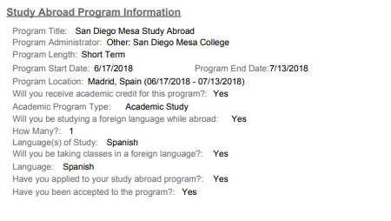
Sample Spain applicant info

Slide 17
Institution Information Study Abroad Program Information
Program Administrator: San Diego Mesa College
Program Title: Use title from poster
Program Start Date: see program dates
Program End Date:
Program Location: San Jose, Costa Rica or Madrid, Spain
Will you receive academic credit for this program?:
YES
Academic Program Type: STUDY ABROAD, WINTER OR SUMMER 2018
Will you be studying a foreign language while abroad: YES (SPANISH 210/211) NO (BIOLOGY 180) SPAIN YES
Language(s) of Study:SPANISH

Slide 18
Study Abroad Program Information continued
Have you applied to your study abroad program?:YES (YOU MUST APPLY TO QUALIFY AND FOR THE ADVISOR TO CERTIFY)
Have you been accepted to the program?:YES
If no, when will you be accepted?:
Will you be taking classes in a foreign language?:YES, IF SPANISH/ NO IF BIOLOGY
Language:SPANISH
How Many?:1
Program Length: JAN 1-25 (COSTA RICA) OR JUNE 4- JULY 13 (SPAIN)
When will you apply?:

Slide 19
Financial Aid Information
Are you currently receiving a Pell Grant or will you be receiving a Pell Grant while abroad?:THIS MUST BE YES! TO QUALIFY
Follow-On Service Project
Statement of Purpose
Estimated Total Study Abroad Program Cost: include program cost plus tuition, books, flight, incidentals
Estimated Financial Aid Amount (excluding loans)

Slide 20
Important data & dates
60% study language abroad
47% first generation
55% are of diverse racial/ethnic background
3,000 scholarship available 2018-2019
27% selection rate

Slide 21
Deadlines
Deadline 1st Tues Oct Advisor 2nd Tues Oct
Students notified 1-3 month(s) before departure
Summer 1st Tues, March 2nd Tues, March

Slide 22
Writing an successful essay
Prepare, write, write, make connections

Slide 23
Goal: Three pronged

Slide 24
Two essays
Statement of purpose
Essay 1: Tells their story
Essay 2: Propose what they will do after they return, solid one will target a unique student population to promote Study Abroad

Slide 25
Suggestions & Tips
Central Theme
Who is your audience: study abroad professionals/faculty/professors’
Formatting can make a difference (double space/margins etc.)
Describe things
Be specific to the (study abroad program) -your academic plan, future plans

Slide 26
The program is importanat
What appeals to you about the program?
The more details you can incorporate about the program – that’ll impress them too.
Speak from your heart
Maybe take your conclusion and put it at the beginning (particularly if it’s clearer/sometimes we begin writing without focus and achieve this towards the end)

Slide 27
Style
Style: can you use a short sentence that impacts? Ex- can you write a sentence with two words only
Imagine: Conversational Tone / like a letter to a Professor/ friend. Not too casual or too stuffy.
Read it out loud
Prove your passion/ show your motivation /show knowledge
Create a strong lead sentence- first sentence –

Slide 28
Stay connected
Talk about yourself
Save something good for the end
Related and specifically say you are : (but keep connected)
-community college
-minority/ from a minority serving institution
-1st generation etc

Slide 29
You are worth the investment
Articulate the how (remember this is for $$-)
How are you a worthy investment
Who am I and why am I worth investing in
Make the case that you are a special /unique candidate (background/1st gen/ 2nd language learner/ etc.)

Slide 30
1-Who are you now? 2- Why do you want to study abroad? 3- Who will you be/how will this experience (effect/transform) you?
Personally Academically

Slide 31
Complete to brainstorm
Situational | Choices | Relationships | Interests

Slide 32
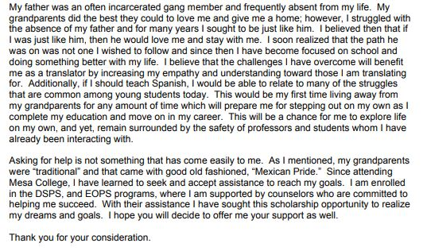
Sample Statements, partial essay

Slide 33
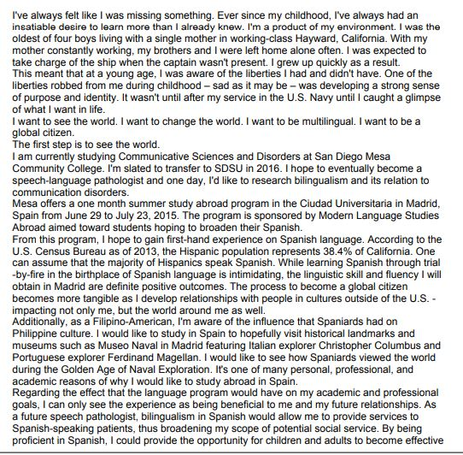

Slide 34
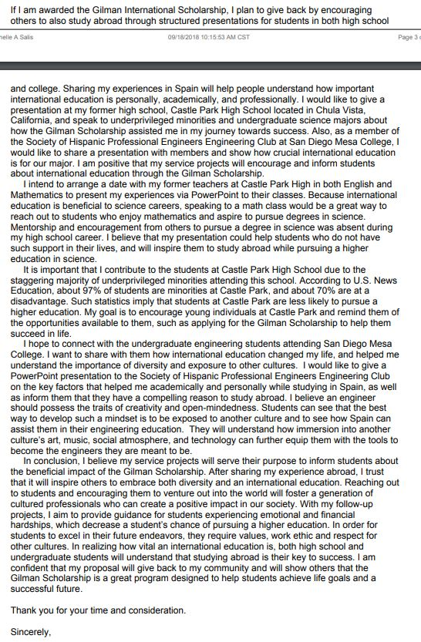
Follow up project

Slide 35
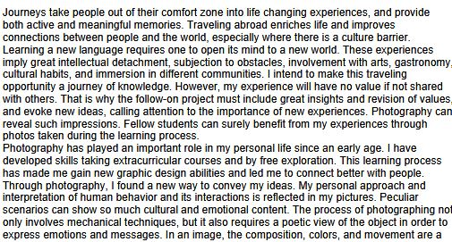
Follow up sample 2

Slide 36
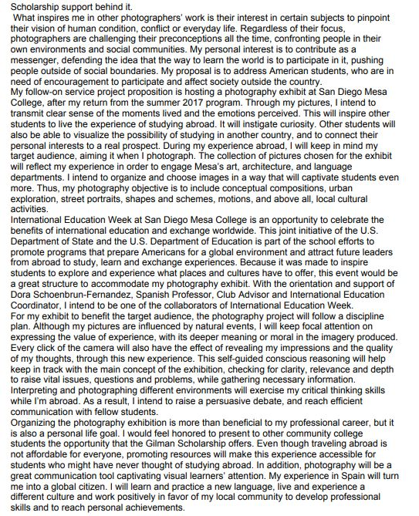

Slide 38
Contact Information
Prof. Dora Schoenbrun-Fernández
International Education Coordinator
Gilman Adviser
(619) 388-2228
G-237
dschoenb@sdccd.edu

