Slide 1
Anatomical Terminology Practice Exam #1

Slide 2
*For best results on these practice exams, write your answers on paper before clicking to see the correct answer and make sure to check your spelling!
Using proper anatomical terminology, name the following body regions and landmarks:

Slide 3
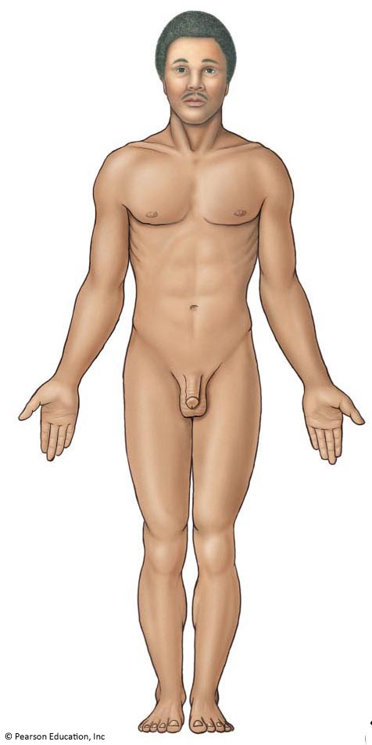
1
*click to the next slide to check your answer

Slide 4
Cranial (cranium)

Slide 5
2
*click to the next slide to check your answer

Slide 6
Cervical (cervicis)

Slide 7
3
*click to the next slide to check your answer

Slide 8
Thoracic (thorax)

Slide 9
4
*click to the next slide to check your answer

Slide 10
Pubic (pubis)

Slide 11
5
*click to the next slide to check your answer

Slide 12
Pectoral (pectoris)

Slide 13
6
*click to the next slide to check your answer

Slide 14
Axillary (axilla)

Slide 15
7
*click to the next slide to check your answer

Slide 16
Brachial (brachium)

Slide 17
8
*click to the next slide to check your answer

Slide 18
Antecubital (antecubitus)

Slide 19
9
*click to the next slide to check your answer

Slide 20
Femoral (femur)

Slide 21
*click to the next slide to check your answer
10

Slide 22
Hallucis (hallux)

Slide 23
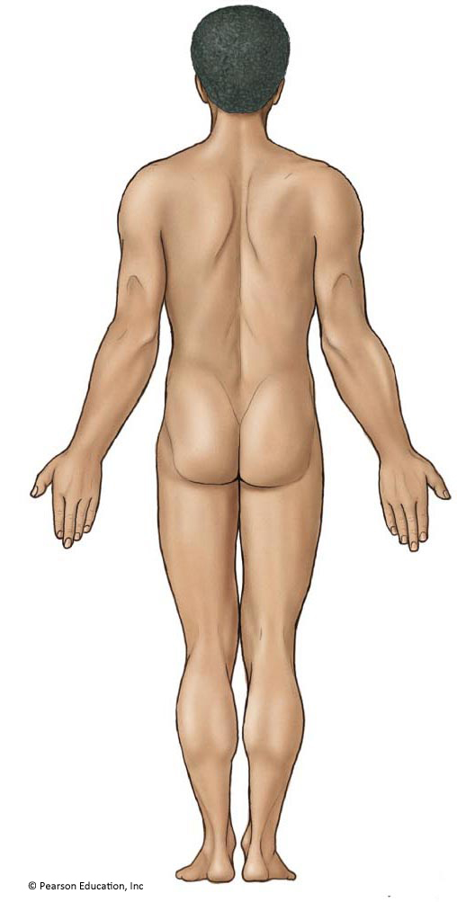
11
*click to the next slide to check your answer

Slide 24
Lumbar (lumbus)

Slide 25
12
*click to the next slide to check your answer

Slide 26
Carpal (carpus)

Slide 27
13
*click to the next slide to check your answer

Slide 28
Popliteal (popliteus)

Slide 29
14
*click to the next slide to check your answer

Slide 30
Antebrachial (antebrachium)

Slide 31
15
*click to the next slide to check your answer

Slide 32
Digital (digits/phalanges of upper extremity)

