Slide 1
Mesa Pathways Retreat
February 8, 2019
FLEX #100736

Slide 2
President Pamela Luster

Slide 3
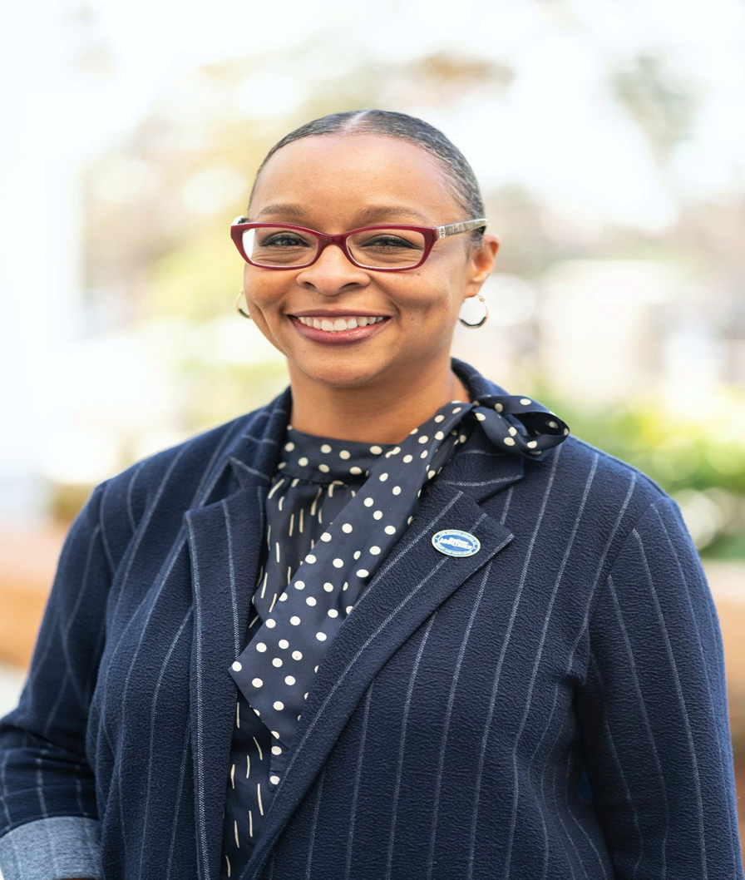
Dr. Ashanti HandS
Vp Student services

Slide 4
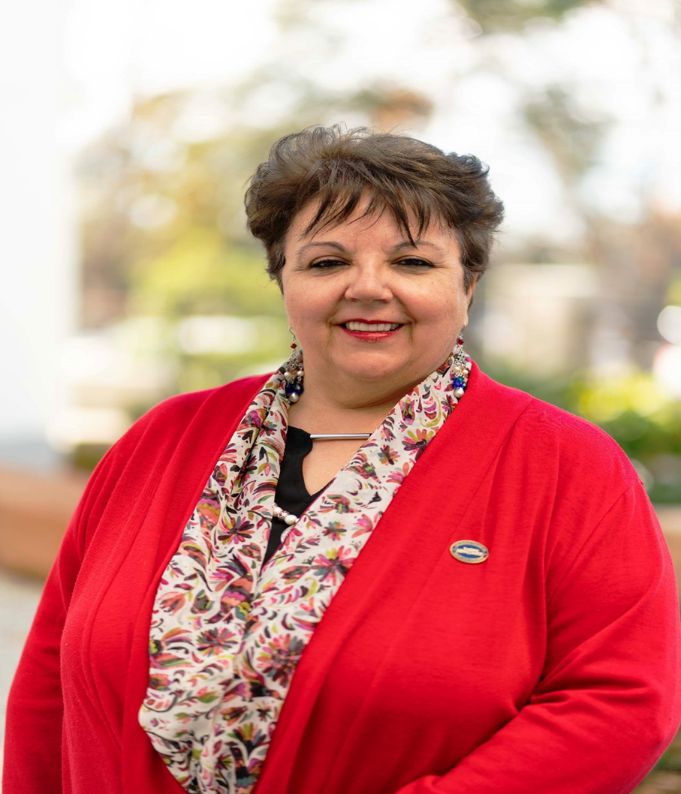
Dr. Isabel O’CONNOR
VP INSTRUCTION

Slide 5
DR. AL SOLANO

Slide 6
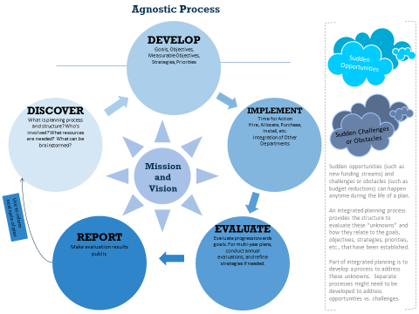

Slide 7
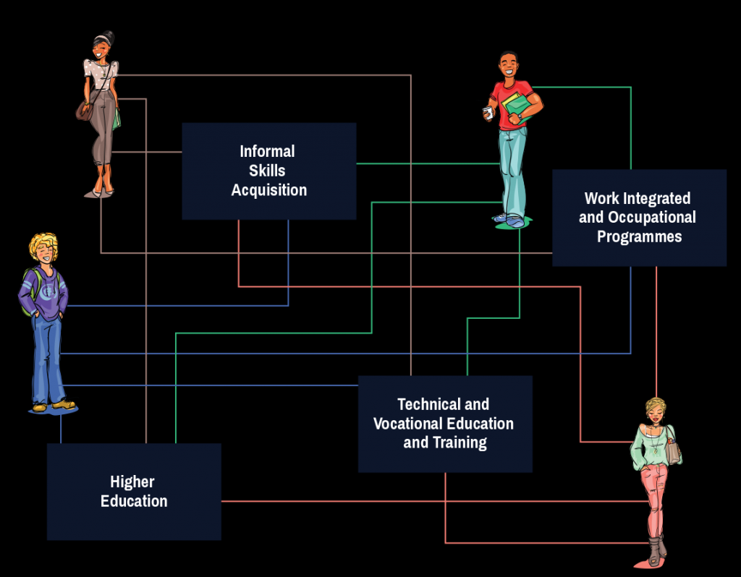
Program mapping activity
Program description
Skills students will develop
Career opportunities

Slide 8
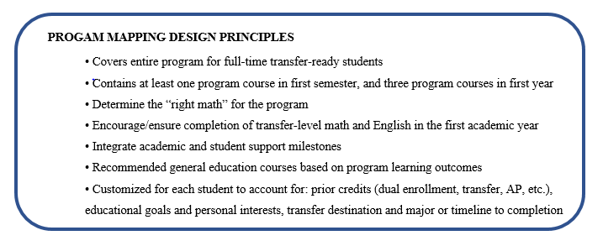
Points to consider

Slide 9
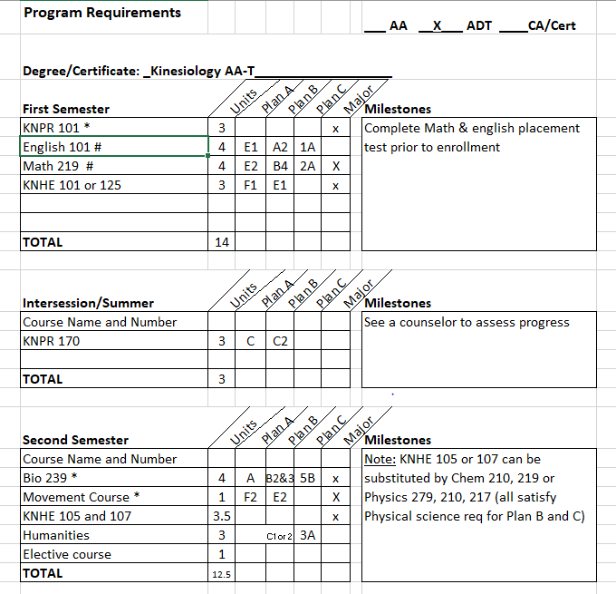
MAPPING EXAMPLEs

Slide 10
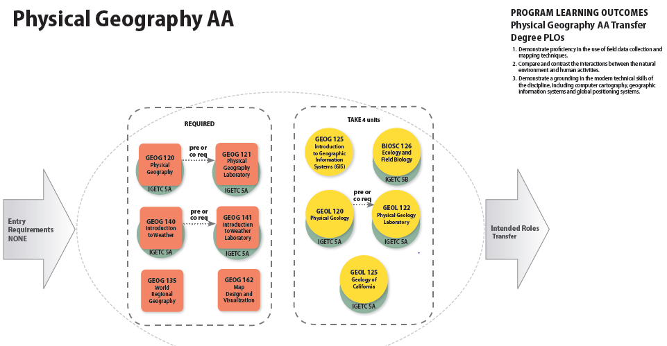
MAPPING EXAMPLEs

Slide 11
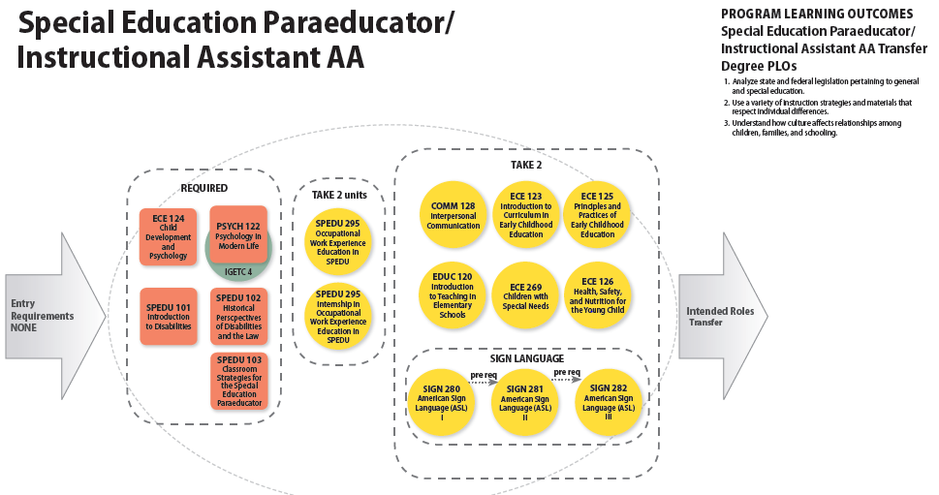
MAPPING EXAMPLEs

Slide 12

Focus AREA or AREAS OF INTEREST SORTING activity

Slide 13


