Slide 1

CVC OEI Update
Joint School Meeting
04-10-2024
By Dr. Ailene Crakes, Dean of Student Development

Slide 2

SDCCD CVC OEI Reps/Team Leads
Susan Topham, Vice Chancellor, Ed Services
Victor Devore, Dean of Student Services
Brian Weston, Dean of Online Learning
Margarita Murray, Student Services Analyst, Student Services
Robbi Ewell, City College, School of Information & Learning Technologies
Michael Odu, Miramar College VP, Instructional Services
Shelly Hess, Dean of Curriculum and Instruction
Ailene Crakes, Mesa College Dean of Student Development

Slide 3
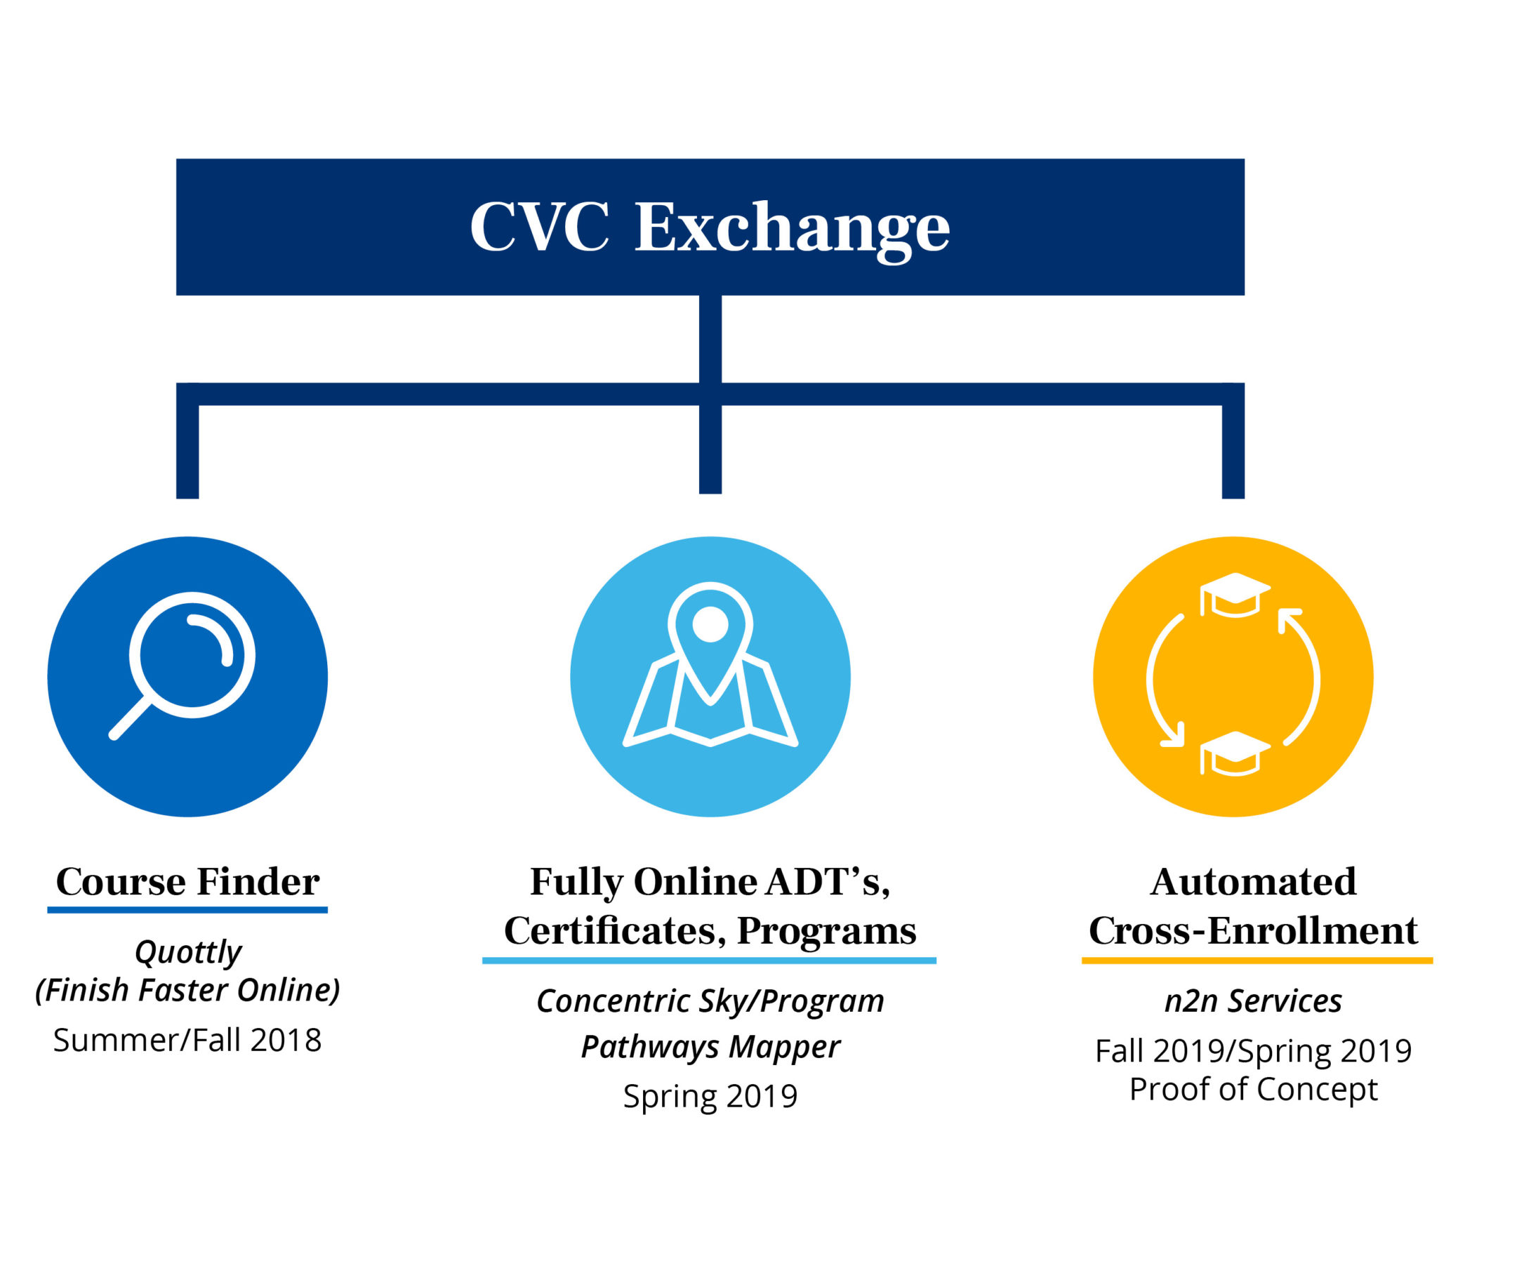
How it Started
2022-2023 Emergency Conditions Allowance - June 14, 2022
  CVC defines “committing to” to mean that the process has been started by the college/district and is in progress.
Title 5 section 58146 intent:
  Districts should not lose FTES apportionment as a result of an emergency or extraordinary condition.
This Photo by Unknown author is licensed under CC BY.

Slide 4
CVC Consortium
Addressing online achievement gaps
Increase student access to fully resourced online course
Propel students toward completion

Slide 5

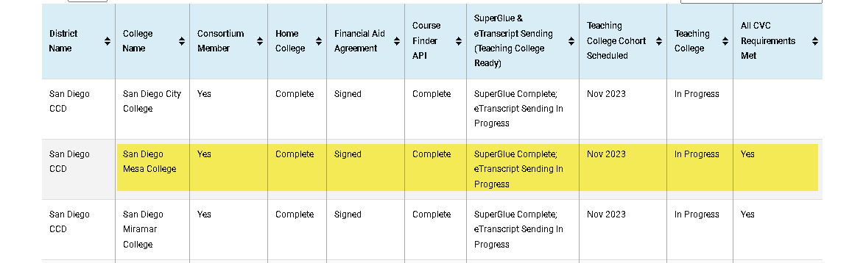
Requirements
Prepare an Emergency Conditions Recovery Plan
Incentivize & prioritize participation in professional development to enhance quality online teaching & learning
District to be a member of the CVC – OEI Consortium

Slide 6

Resources offered through CVC:
Participation in the CVC Exchange, as Home and Teaching Colleges.
Access to data and enrollment dashboards through the Exchange.
Resources such as the Online Course Design Rubric, CVC@ONE online educator certification, adoptable courses, webinars, and other professional development opportunities.
Shared technology such as Canvas, the state’s common course management system, and other tools including Canvas Studio, Impact, NetTutor, and Pisces.

Slide 7

Timeline
CVC Exchange Checklist
May 2014
Call for Participation issued for the pilot phase to begin in spring 2015. 23 pilot colleges selected based on demographics, geographic location, and technology
2018
CVC expanded the number of colleges from 23-57
2020
colleges accepted on a rolling basis
Nov. 2023
113 consortium colleges

Slide 8

College Implementation Tracker
Indicates colleges’ completion of the benchmarks for the Emergency Conditions Athe Emergency Conditions Allowance Memo (FS 22-07) benchmarks), distributed by the Chancellor’s Office on June 14, 2022. The college/district meets the conditions pertaining to the CVC if it:
  is a member of the CVC-OEI Consortium and has signed the Master Consortium Agreement.
  by the beginning of the first term that starts on or after January 01, 2023, has implemented the steps to become a Home College and has implemented or committed to
    enabling Course Finder API
    completing the steps needed to become Teaching College ready, and
    joining a scheduled implementation cohort to become a Teaching College.

Slide 9

College Implementation Tracker (cont'd.)
  Join the CVC-OEI Consortium: Sign the Master Consortium Agreement and email that document to support@cvc.edu.
  Become a Home College on the CVC Exchange: This means that a college has completed the technical steps to allow its students to take cross-enrollable courses at Teaching Colleges on the CVC Exchange.
  Federal Financial Aid Consortium Agreement: Once signed, your college’s students can request federal financial aid and combine units across colleges
  Enable the Course Finder API: Will ensure that colleges have their live seat counts reflected on the CVC Exchange.
  Become “Teaching College Ready”: The additional steps needed for districts to become Teaching College ready (meaning being ready for Teaching College technical integration) are: (a) enabling sending of e-transcripts through eTranscript California and (b) enabling Super Glue with the CCC Technology Center.

Slide 10
Search Filter
To have courses listed on the CVC Online Course Finder, colleges must have completed Phase 1: Live Schedule Integration (SDCCD is almost done)
1
The stated intention of the CVC Exchange is to provide a platform for students to cross-enroll in courses at CCCs.
2
CVC is piloting a default search filter that will show students only cross-enrollable courses (i.e. courses at teaching colleges).
3
Badges Before - Consortium College, Quality Reviewed, Online Tutoring, Online Counseling, Online Student Readiness, Zero Textbook Cost (ZTC).
4
Badges shifting in 2023 - Quality Reviewed, Online Tutoring, Zero Textbook Cost (ZTC).
5

Slide 11
Updates
Some topics need to be decided at the local college level, such as the clearing of prerequisites.
Educational Services is finalizing the payment piece, so all payments are through CVC OEI.
Communications
Welcome letter to students is being finalized.
Susan and Jess are working on a communication letter to students and to faculty that will be distributed by January 26.
Websites
Faculty website with a FAQ will be created by Brian Weston
Student website will be created by Susan, Jess, and Carol
Educational Services will provide each of the colleges with the faculty and student website links so they can be included on the college websites.
The primary goal is to build the infrastructure that shows we are in compliance with the Emergency Conditions Allowance requirements and to demonstrate that SDCCD is making an effort to fully implement.

Slide 12

Updates
Meeting on a weekly basis with CVC OEI Team
Almost completed phase one of the project
Asked for an extension due to challenges with programming
Asked for one month from March 29 to April 29
Working on creating a website for faculty and staff that can be added to our websites and will be housed by the district
Two letters, one to go out to students and one for faculty that has links to all the pages and will go out closer to the launch date
Still have issues with students not being enrolled in the home campus and able to enroll for CVC OEI courses
This Photo by Unknown author is licensed under CC BY-SA-NC.

Slide 13

Other Updates
Looking to test the search match
Double check for duplicates
First name, last name, and DOB, we will not do their CCC ID initially
They will be provisioned an sdccd.edu email address
How do we handle the accommodations? Is it handled by the home college or transmitted to the district
They will have a CVC service indicator
Can only add and drop classes from CVC
Admissions, FA, and Counseling will have access to service indicators
They will have a hold because they won’t be able to apply for financial aid at the teaching college because they have a home college where they can apply
Add and drop needs to be done through CVC and not CS
Refund needs to be manually done
Clearing of prerequisites
Canvas Integration
2 courses limit on the exchange
At least 1 credit at the home college
6 units at the home college to receive FA

Slide 14
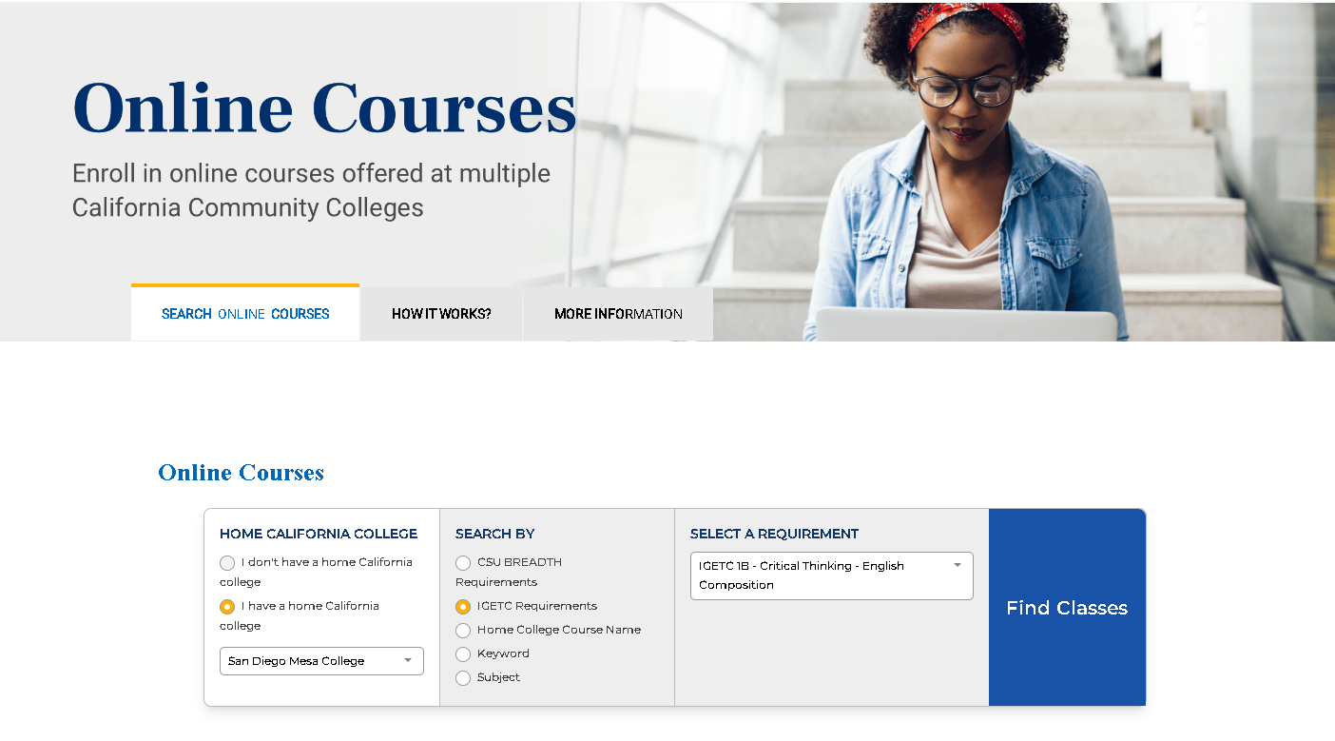
Demo- Go to cvc.edu

Slide 15
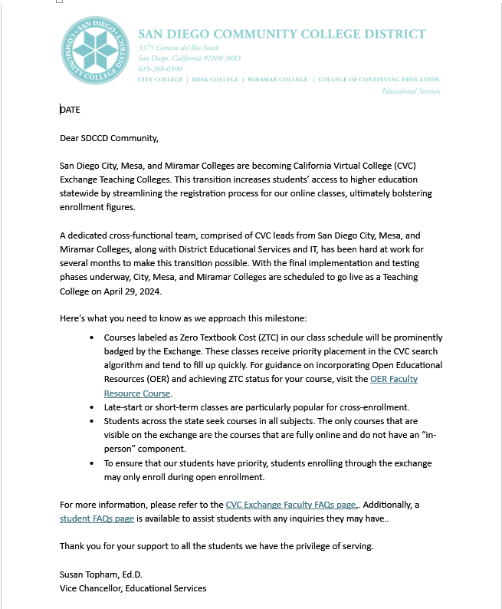
CVC Teaching College Announcement Letter

