Slide 1



sdccd.joinhandshake.com/login

Slide 2
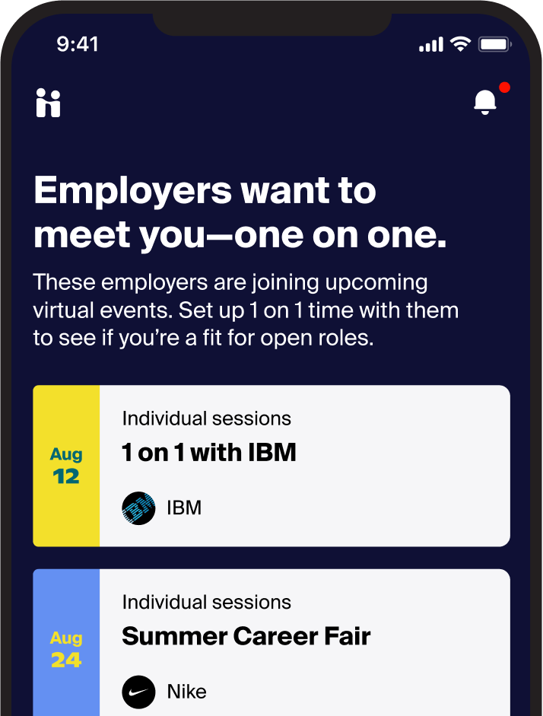

Handshake
is the #1 way college students find jobs
#HIREDonHandshake
The goal is to help every student find a great job and build the foundations of a meaningful career, no matter who you are, where you’re from, or who you know.

Slide 3
Get
Started with Handshake
#HIREDonHandshake

Slide 4
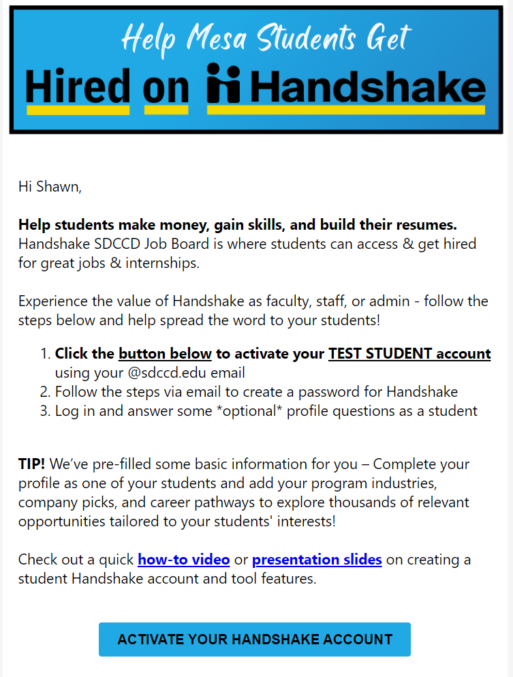
Handshake Activation Email
#HIREDonHandshake
Sent to all Counselors on 2/6 asking for you to activate your Handshake Test Student Account
Click the button
ACTIVATE YOUR HANDSHAKE ACCOUNT
Follow the steps to set my password & create your optional profile

Slide 5
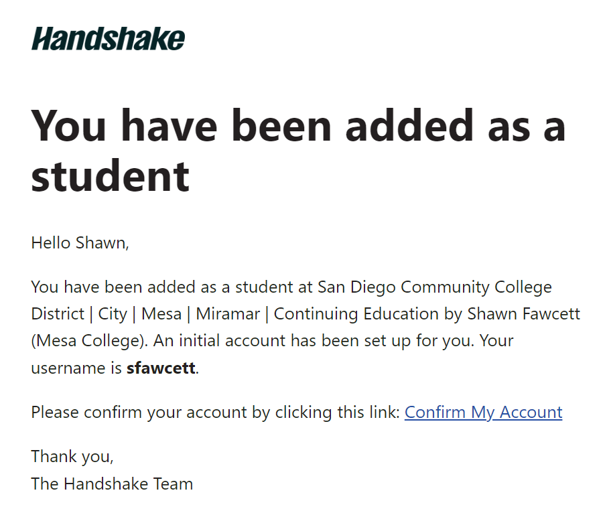
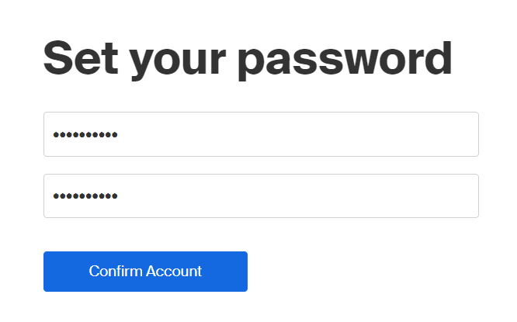
Handshake Activation Email
#HIREDonHandshake

Slide 6
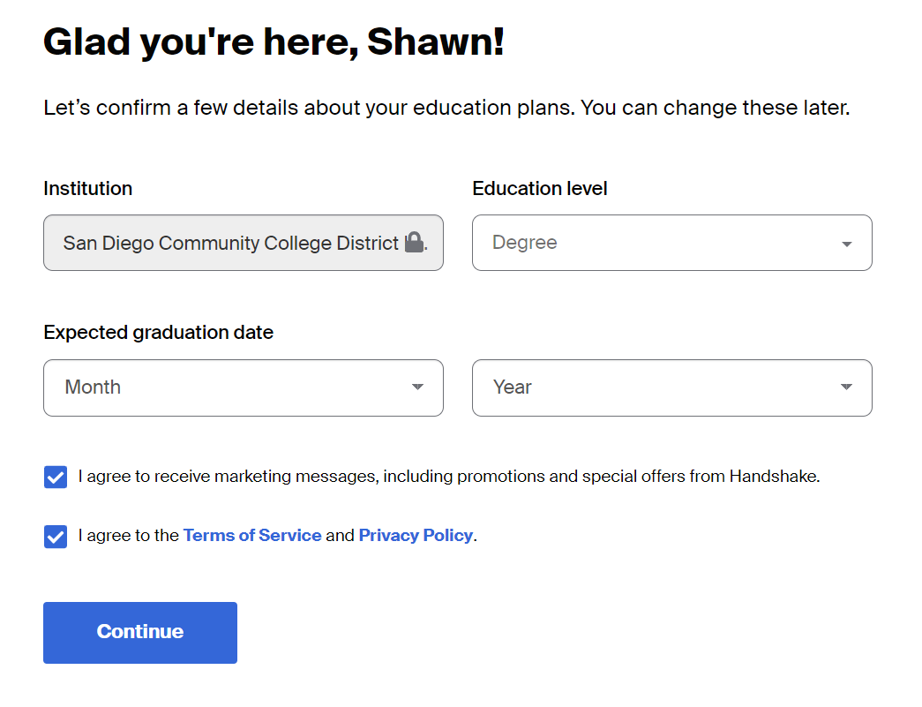
Handshake Account Setup - Education
#HIREDonHandshake

Slide 7
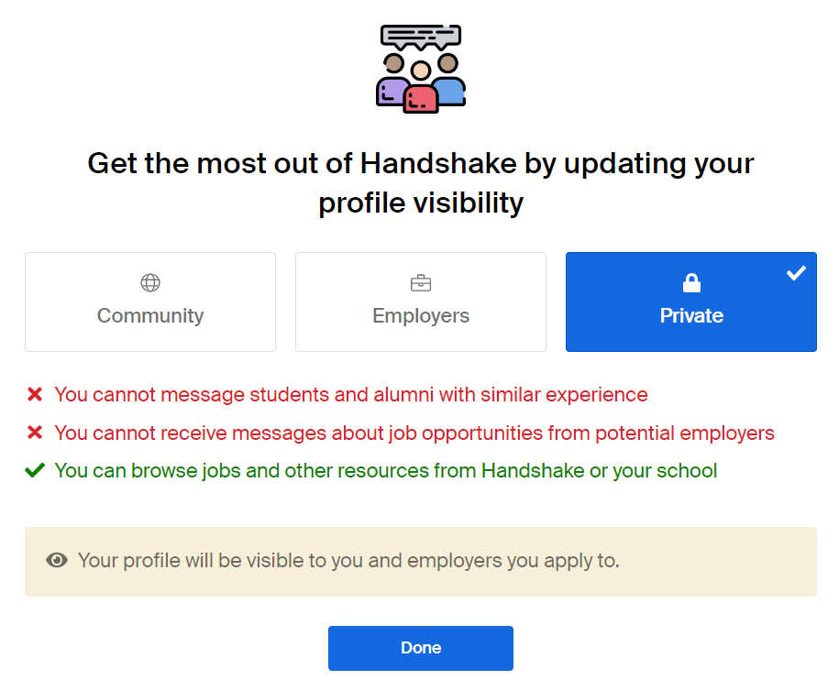
Handshake Account Setup - Profile Visibility
#HIREDonHandshake

Slide 8
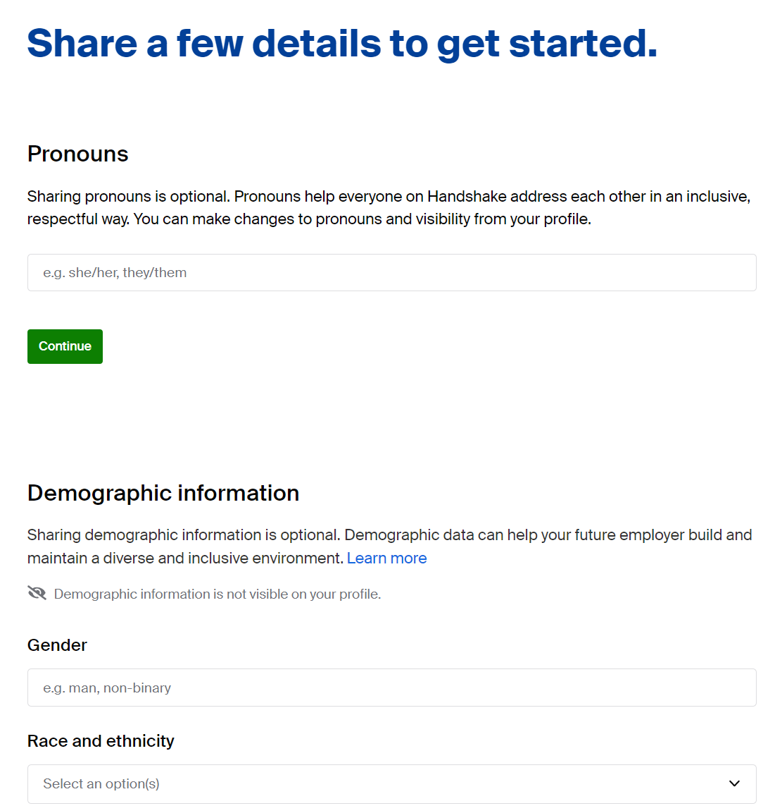
Handshake Account Setup - Profile Details
#HIREDonHandshake
Add in details about yourself as a student
The more details provided, the more specific employer & job information you will receive
OPTIONAL - Click “Continue”
Can be changed in your profile later at any point
About You - Demographics, Background, Skills, Coursework, GPA, Clubs, Employment history
About Work - Type of Job, Where to Work, Industries, Employer Traits, Types of Jobs

Slide 9
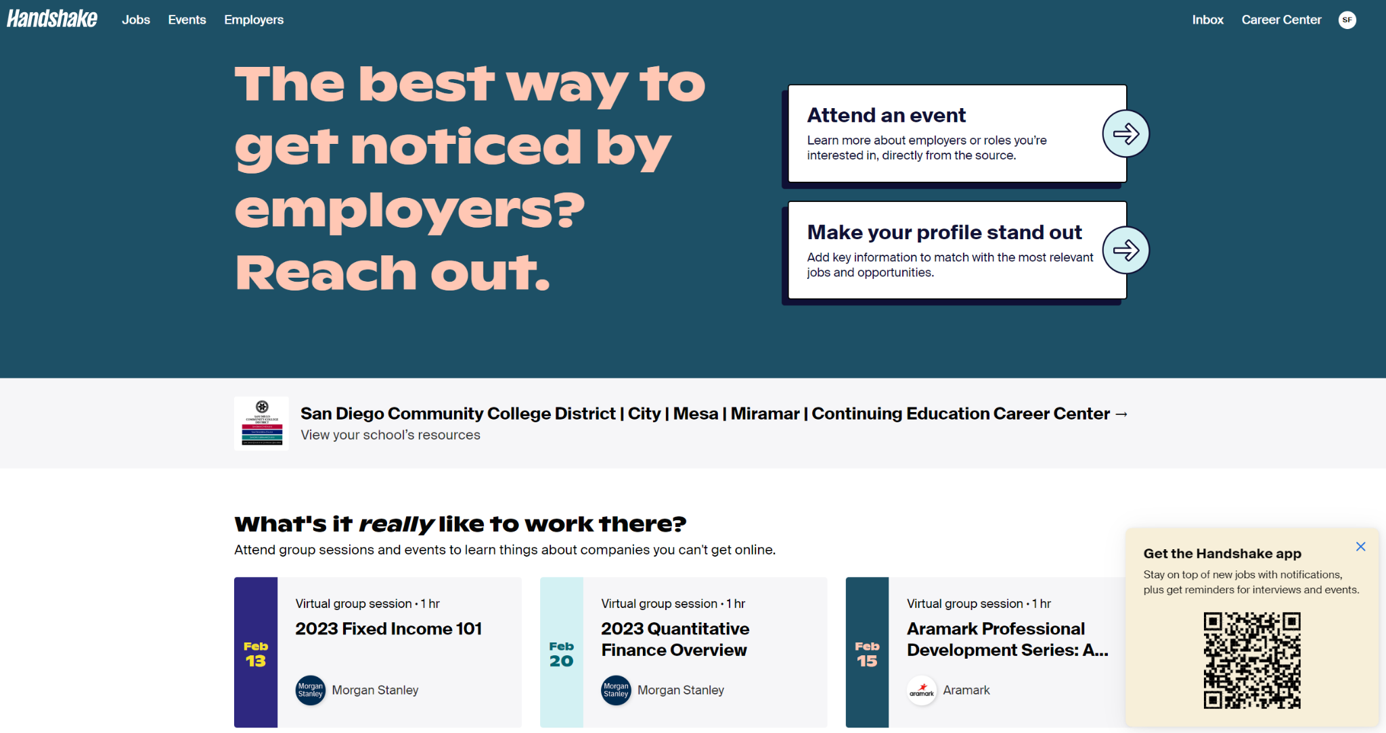
Handshake Account Setup - Profile Details
#HIREDonHandshake

Slide 10

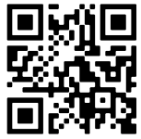


Login to Handshake
#HIREDonHandshake
Login with your MySDCCD email at
sdccd.joinhandshake.com/login
Download the app
Search for “Handshake” on the App Store or Google Play or visit app.joinhandshake.com

Slide 11
Share with your students: Encourage them to active or create a free account
Encourage your career industry connections & employers to post jobs and internships
Create a course or extra credit assignment using this platform
Use your test student account to share job/internship opportunities with your students - Receive notifications
With your support, it creates a campus culture where career is everywhere
How Can Faculty Use Handshake?
Notes:
Faculty will be able to create fake student accounts so they can use the tool themselves (search for jobs, register for events, etc.) and also receive employer notifications for job/internship opportunities to share with students.

Slide 12
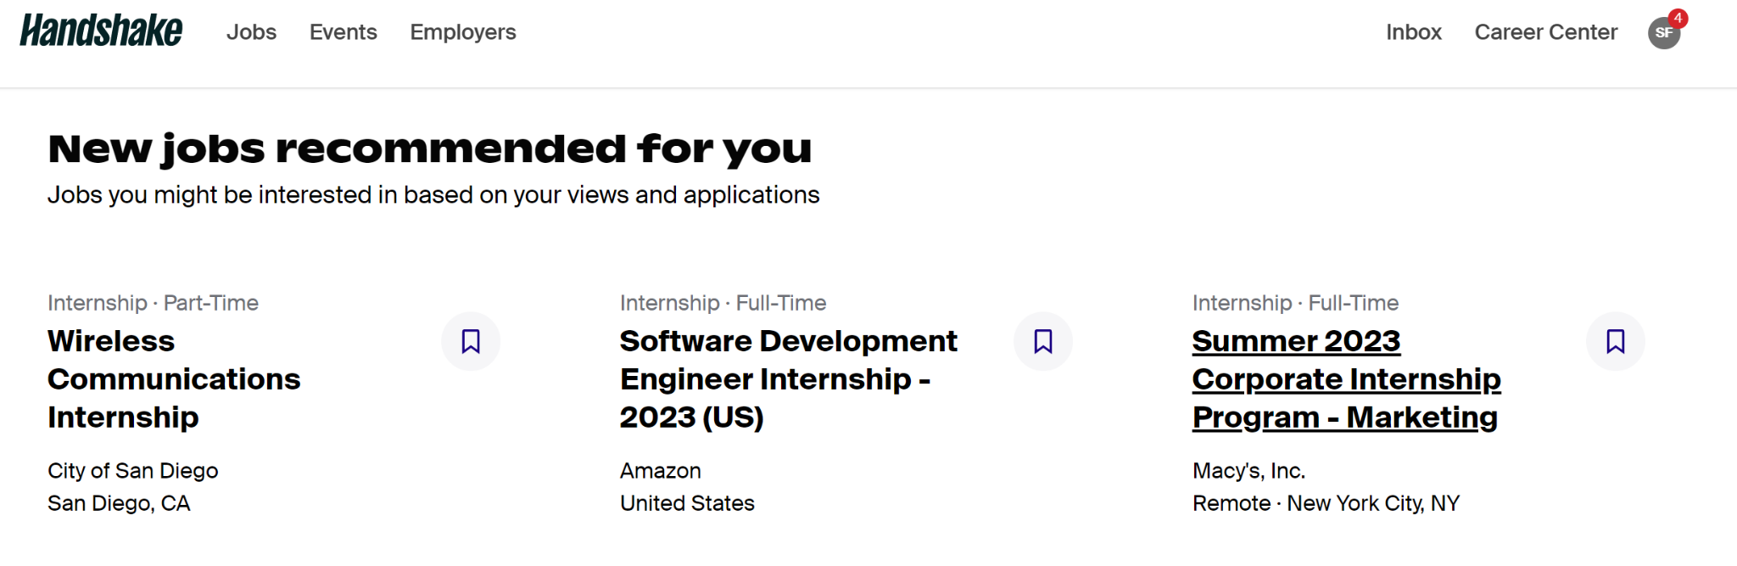
#HIREDonHandshake
Let’s Demo & Get #HIREDwithHandshake

Slide 13

sdccd.joinhandshake.com/login

